Slide 1
Solution to the Number Rotation Puzzle
Thomas Lam

Slide 2
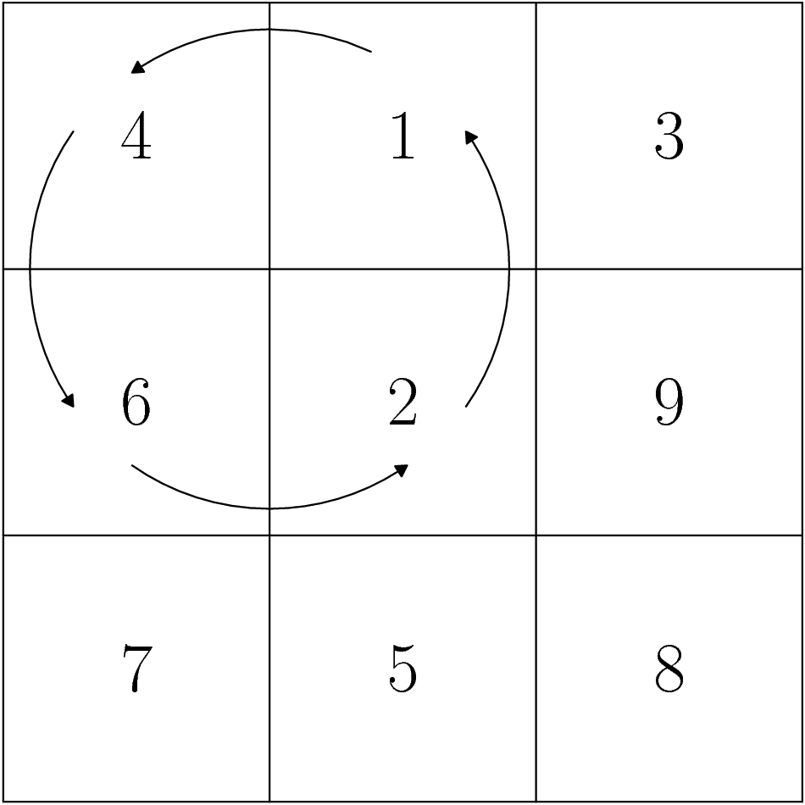
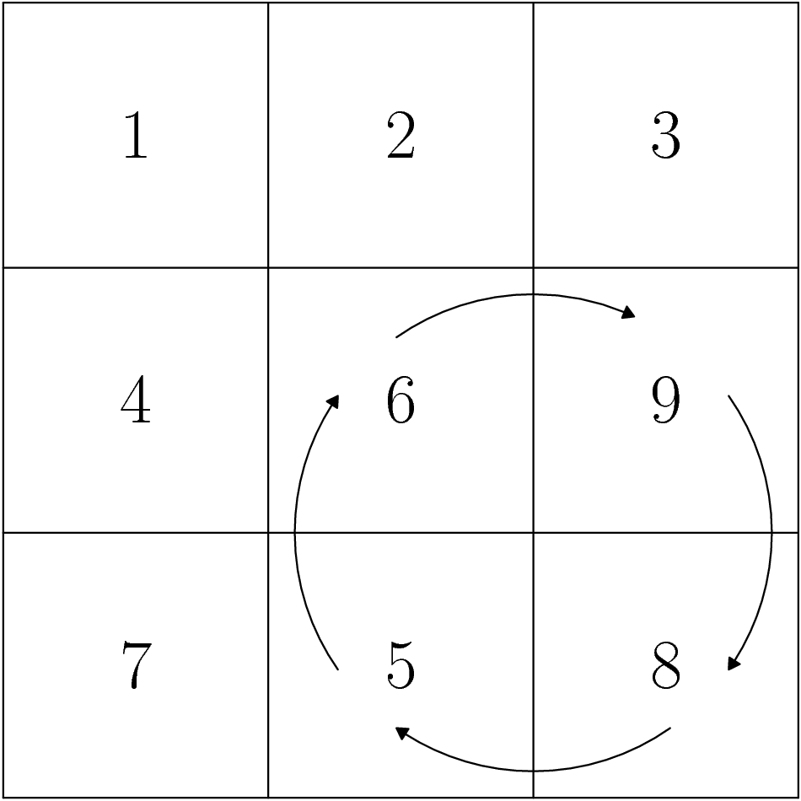
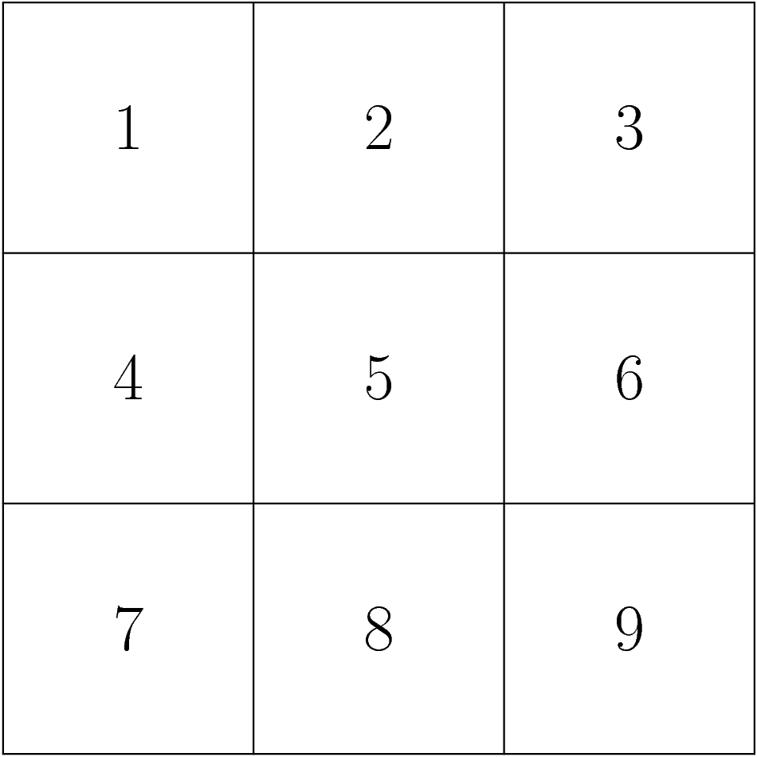
The Classical NRP
Given a 3 x 3 board of positive integers from 1 – 9
Can rotate 2 x 2 blocks by a multiple of 90 degrees.
Goal: Get the numbers back into order.

Slide 3
Bigger Boards, Bigger Blocks!
To make the game harder, you can make things bigger!
  Increase the dimensions of the board
  Increase the size of the rotating blocks

Slide 4
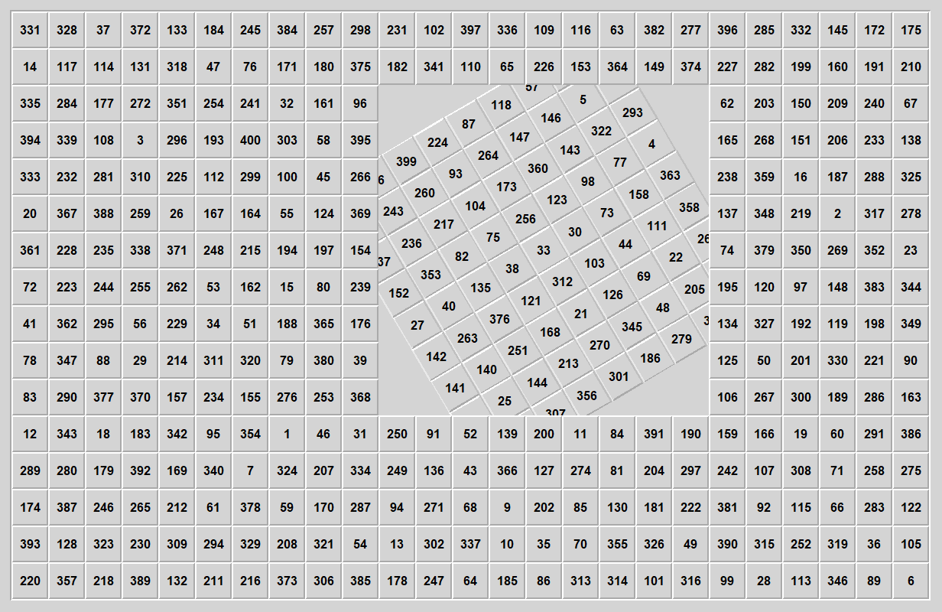

Slide 5
Goal
We say a game/puzzle is “solved” when all possible solvable initial configurations are found, and the strategy for solving such boards is found.
  1. Find all initial boards that are NOT solvable, with proof.
  2. Prove that all other possible initial boards are solvable by deriving a solving algorithm.
Solve the NRP over all square boards. (Already done by Ravi Fernando)
Solve the NRP over all rectangular boards.

Slide 6
Notation
Dimensions of board: m x n
Dimensions of rotating block: b x b

Slide 7
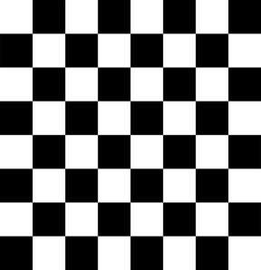
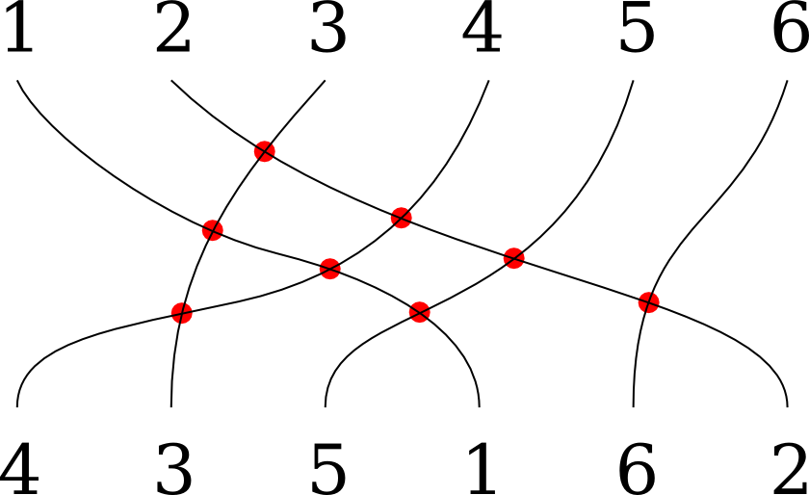
The Parity Restrictions (PRs)
The Parity Restrictions are a set of conditions that can be used to determine if a board is solvable.
  We will soon see that, in the general case, the PRs are sufficient for determining solvability!

Slide 8
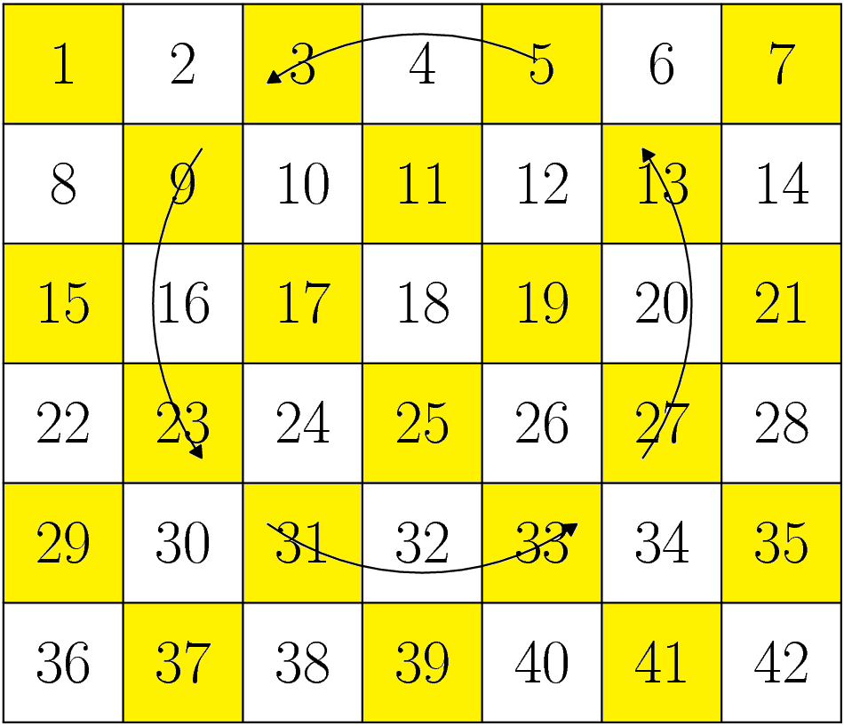
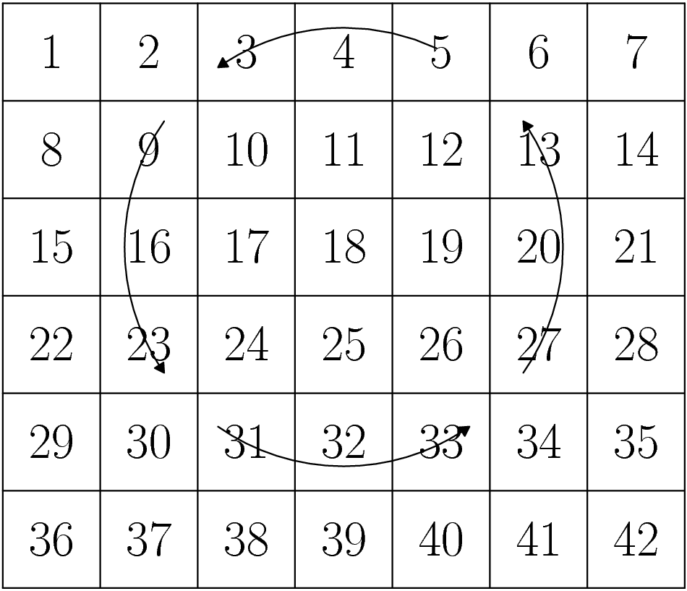
First PR: Parity of Square
For odd b, every number stays on the same parity when moved.
Conclusion: If b is odd, then each number must start on the correct parity for the board to be solvable.

Slide 9
Quick Review: Parity of a Permutation
Consider the permutation [2, 1, 4, 5, 3] of [1, 2, 3, 4, 5].
This permutation can be executed in three swaps:
  [2, 1, 3, 4, 5]
  [2, 1, 4, 3, 5]
  [2, 1, 4, 5, 3]
It can also be executed in five swaps:
  [1, 4, 3, 2, 5]
  [2, 4, 3, 1, 5]
  [2, 1, 3, 4, 5]
  [2, 1, 4, 3, 5]
  [2, 1, 4, 5, 3]
In fact, the number of swaps will always be odd.
We hence call [2, 1, 4, 5, 3] an odd permutation.
In general, we may classify any permutation as even or odd, based on the number of swaps needed to make it.

Slide 10
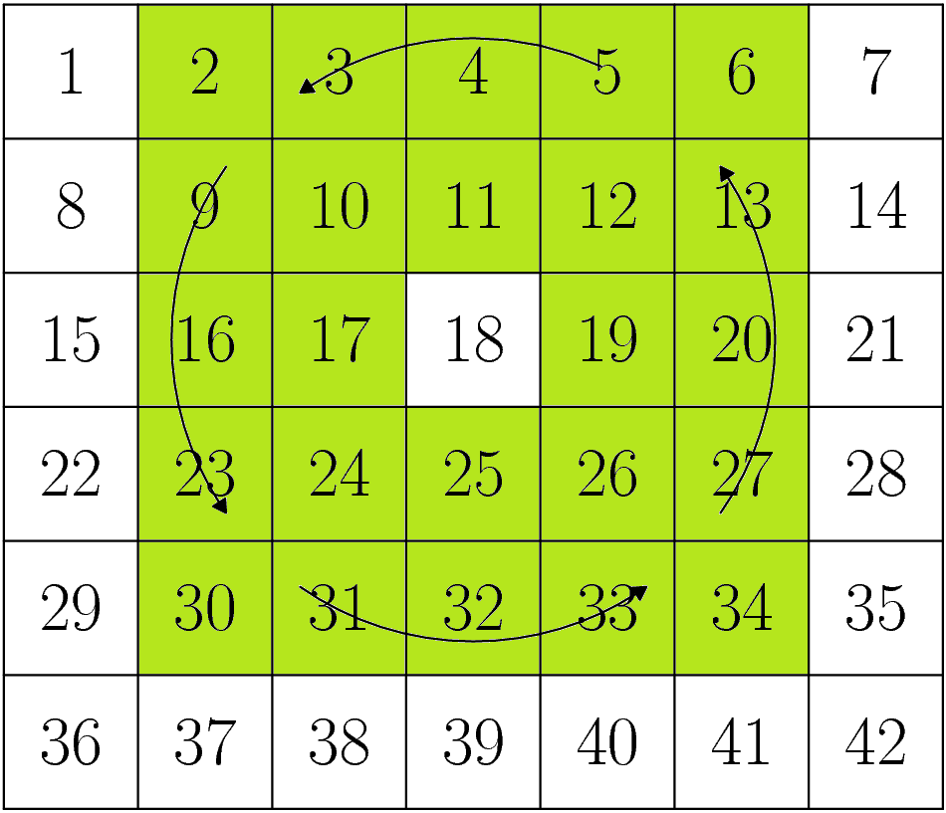
Second PR: Parity of Permutation
Interpret each move as a permutation.
The permutation may be odd or even.
  When is it even? → Use counting and modular arithmetic.
  Numbers move in 4-cycles.

Slide 11
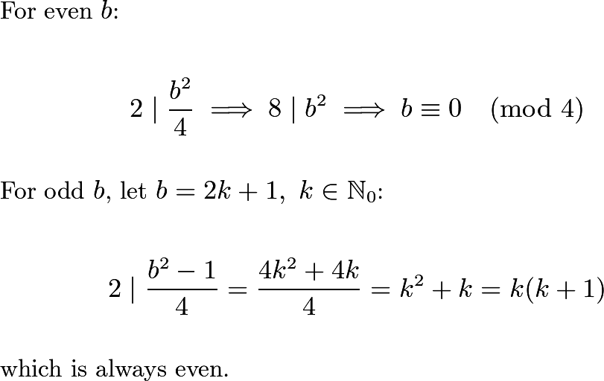

Slide 12
Second PR: Parity of Permutation
Interpret each move as a permutation.
The permutation may be odd or even.
  When is it even? → Use counting and modular arithmetic.
  Numbers move in 4-cycles.
Conclusion: If b ≡ 0, 1, 3 (mod 4), moves execute even permutations, so the starting board must be an even permutation to be solvable.

Slide 13
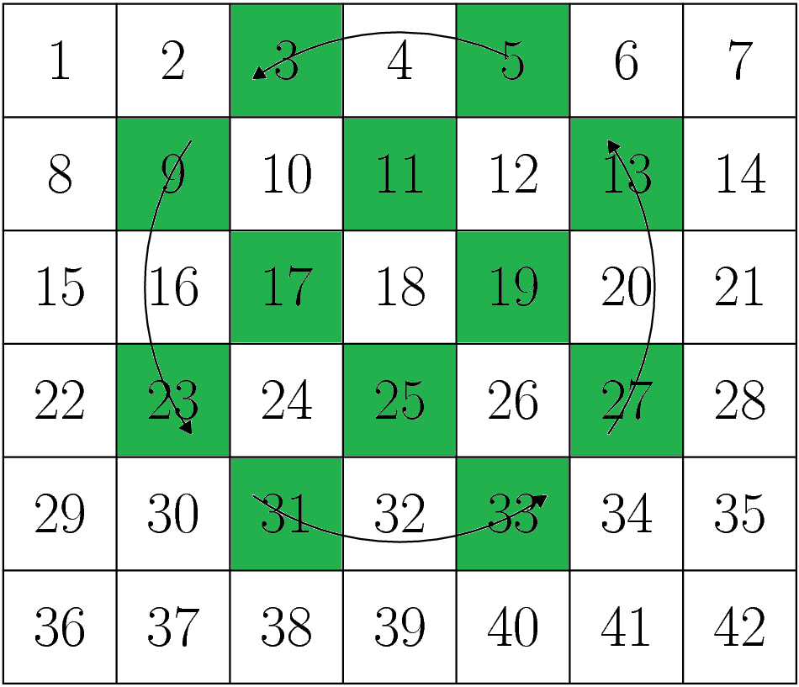
Third PR: Parity of Permutation within Parity of Square
Recall that if b is odd, the NRP can be split into two parities, with no numbers ever moving between them.
In this case, each move can be interpreted as two permutations, each on a different parity!
If either of these separate permutations are even, we’ll have additional PRs.

Slide 14
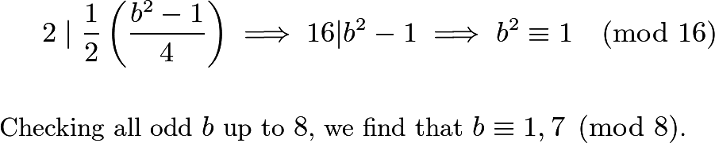

Slide 15
Third PR: Parity of Permutation within Parity of Square
Recall that if b is odd, the NRP can be split into two parities, with no numbers ever moving between them.
  In this case, each move can be interpreted as two permutations, each on a different parity!
  If either of these separate permutations are even, we’ll have additional PRs.
Conclusion: If b ≡ 1, 7 (mod 8), each parity must be an even permutation of their solved states for the board to be solvable.

Slide 16
Summary of PRs
If b ≡ 2 (mod 4)
No conditions.
If b ≡ 0 (mod 4)
Initial board must be an even permutation of solved state.
If b ≡ 3, 5 (mod 8)
Initial board must be an even permutation of solved state.
Every number must start in its correct parity.
If b ≡ 1, 7 (mod 8)
Each parity must be an even permutation of the solved state.
Every number must start in its correct parity.
This is sufficient for b ≥ 5, m > b !!!

Slide 17
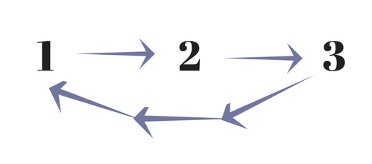
An Essential Weapon: The 3 - Cycle
The basic component of an even permutation.
  If you can find an algorithm that can execute any desired 3-cycle, subject to PRs, it follows that you can execute any even permutation that obeys PRs.
    If you can execute any even permutation, we’re done because…
      for NRPs whose moves execute even permutations, every possible initial board is an even permutation and…
      for NRPs whose moves execute odd permutations, an initial board that is an odd permutation can be converted to an even permutation by making some random move.
Goal: Be able to execute any 3-cycle

Slide 18
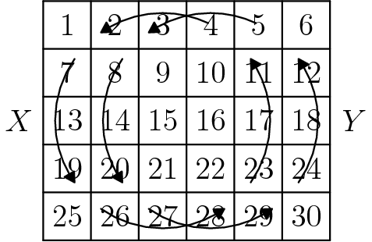
The Hardest NRP?
The n x (n+1) board with n x n rotating blocks has the smallest moveset.
If we can find a 3-cycle here, then theoretically we should be able to find 3-cycles on larger boards (but same rotating block size).
Let the rotation of the left block be X, and let the rotation of the right block be Y.

Slide 19
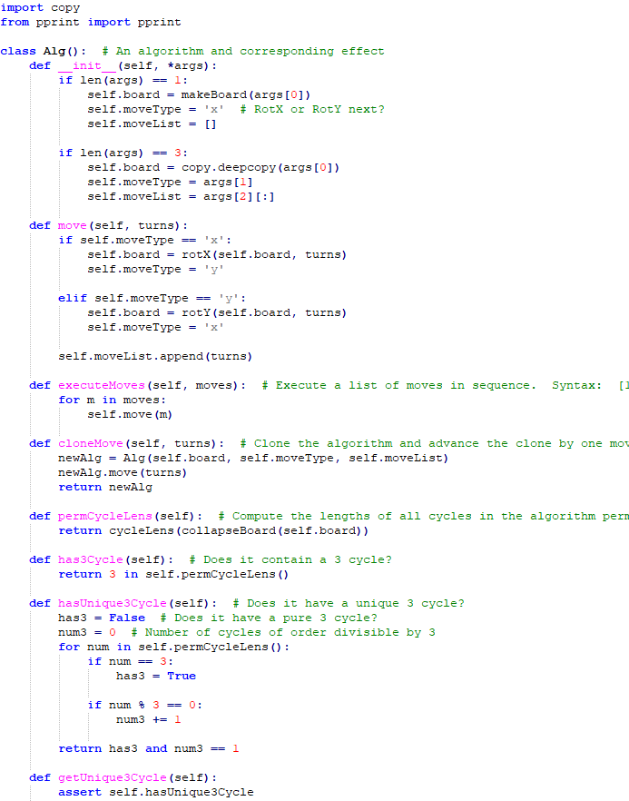

A Brute-Force Search
To find 3-cycles on the n x (n+1) board, I wrote a breadth-first searching algorithm.
  This is a convenient solution because there are only two possible rotations, so any algorithm can be represented as a string in trinary, and then placed in a tree.

Slide 20
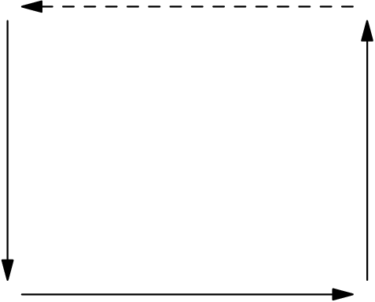
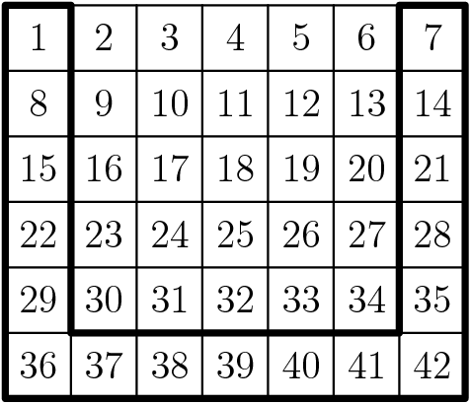
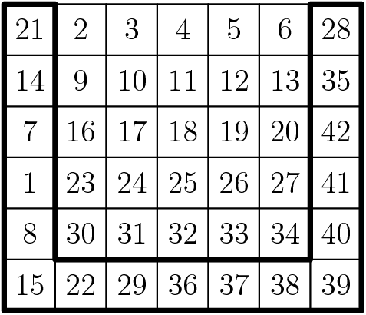
Cycle
A simple 8-move algorithm.
Cycles some numbers around the edge of the board n – 3 squares in one direction.
  This can be proven by noting that the cyclic order of the numbers inside the belt is preserved with each YX, and using some modular arithmetic.
Increases maneuverability.
YXYXYXYX

Slide 21
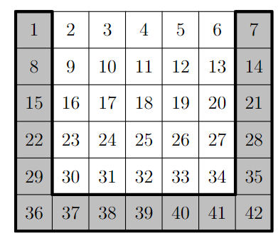
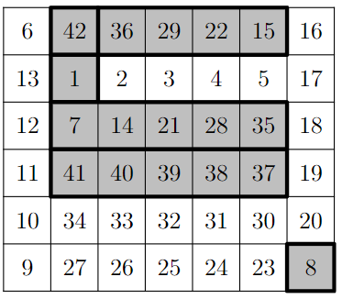
Move Cycle Somewhere Else!
“The Belt”
“The Sus”
A
A := XYYXY⁻¹X⁻¹

Slide 22
The Plan…
Tool 1: We can cycle the belt by doing (YX)⁴.
Tool 2: We can cycle the sus by doing A⁻¹(YX)⁴A.
Now…
Cycle the belt
Cycle the sus
Reverse Cycle the belt
Reverse Cycle the sus
ϕ := (YX)⁴ A⁻¹(YX)⁴A (X⁻¹Y⁻¹)⁴ A⁻¹(X⁻¹Y⁻¹)⁴A

Slide 23

1
2
3
4
5
6
7

Slide 24
Deriving a General 3-Cycle Algorithm
We now have a 3-cycle algorithm, but it only cycles three specific squares.
To find a general 3-cycle algorithm, we need to somehow move the three numbers that we want cycled to the squares that we know can be cycled.
1
2
3

Slide 25
Deriving a General 3-Cycle Algorithm
To get three numbers to any three squares, subject to PRs, it suffices to figure out how to get any three numbers to three intermediate squares.
Numbers Desired
to be Cycled
Common Ground
(Intermediary)
3-Cycle Squares

Slide 26

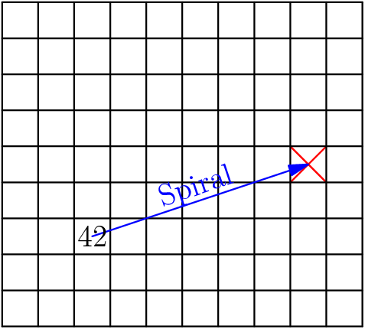
Spiral
An algorithm that can send any number to any square, subject to PRs.
Idea: It suffices to find an algorithm that can send any number to a particular square.
Notes:
[asy]
size(5cm);
void drawGrid(int n, real width){
for(int i=0; i<=n; ++i){
//pair X =
draw((width*i,0)--(width*i,n*width));
}
for(int i=0; i<=n; ++i){
//pair X =
draw((0,width*i)--(width*n,i*width));
}
}
pair b(real x, real y, int n, real width){
//real width = 10.0;
//int n = 8;
real newx = y;
real newy = n+1-x;
return (newx*width-width/2, newy*width-width/2);
}
void drawNumGrid(int n, real width){
drawGrid(n, width);
for(int i=1; i<=n; ++i){
for(int j=1; j<=n; ++j){
pair p = b(i, j, n, width);
string s = (string) (n*(i-1)+j);
label(s,p);
}
}
}
void drawRectGrid(int m, int n, real width){
for(int i=0; i<=m; ++i){
//pair X =
draw((width*i,0)--(width*i,n*width));
}
for(int i=0; i<=n; ++i){
//pair X =
draw((0,width*i)--(width*m,i*width));
}
}
void drawRectNumGrid(int m, int n, real width){
drawRectGrid(m,n,width);
for(int i=1; i<=n; ++i){
for(int j=1; j<=m; ++j){
pair p = b(i, j, n, width);
string s = (string) (m*(i-1)+j);
label(s,p);
}
}
}
void drawCustomNumGrid(int n, real width, int[][] labels){
drawGrid(n, width);
for(int i=0; i<=n-1; ++i){
for(int j=0; j<=n-1; ++j){
pair p = b(i+1,j+1,n, width);
string s = (string) (labels[i][j]);
label(s,p);
}
}
}
void drawCustomRectNumGrid(int m, int n, real width, int[][] labels){
drawRectGrid(m, n, width);
for(int i=0; i<=n-1; ++i){
for(int j=0; j<=m-1; ++j){
pair p = b(i+1,j+1,n, width);
string s = (string) (labels[i][j]);
label(s,p);
}
}
}
void drawRotate(pair c, int size, real width, bool ccw){
real r = (real) size;
r = r/2 * width * .9;
if(ccw){
draw(arc(c, r, 65, 125), ArcArrow);
draw(arc(c, r, 145, 215), ArcArrow);
draw(arc(c, r, 235, 305), ArcArrow);
draw(arc(c, r, 325, 360+35), ArcArrow);
}else{
draw(arc(c, r, 125, 65), ArcArrow);
draw(arc(c, r, 215, 145), ArcArrow);
draw(arc(c, r, 305, 235), ArcArrow);
draw(arc(c, r, 360+35, 325), ArcArrow);
}
}
draw(b(4.5,8.5,9,10)--b(5.5,9.5,9,10),red);
draw(b(5.5,8.5,9,10)--b(4.5,9.5,9,10),red);
drawRectGrid(10, 9, 10);
draw(b(7,3,9,10)--b(5,9,9,10),blue,Arrow);
label(shift((-1)*4.5,(3)*4.5)*rotate(aTan(1/3))*"Spiral",b(7,3,9,10)--b(5,9,9,10),blue);
label("$42$",b(7,3,9,10));
[/asy]

Slide 27
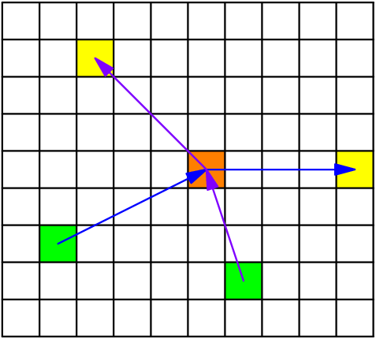
Starting Square
Intermediary
Goal Square
Notes:
[asy]
size(5cm);
void drawGrid(int n, real width){
for(int i=0; i<=n; ++i){
//pair X =
draw((width*i,0)--(width*i,n*width));
}
for(int i=0; i<=n; ++i){
//pair X =
draw((0,width*i)--(width*n,i*width));
}
}
pair b(real x, real y, int n, real width){
//real width = 10.0;
//int n = 8;
real newx = y;
real newy = n+1-x;
return (newx*width-width/2, newy*width-width/2);
}
void drawNumGrid(int n, real width){
drawGrid(n, width);
for(int i=1; i<=n; ++i){
for(int j=1; j<=n; ++j){
pair p = b(i, j, n, width);
string s = (string) (n*(i-1)+j);
label(s,p);
}
}
}
void drawRectGrid(int m, int n, real width){
for(int i=0; i<=m; ++i){
//pair X =
draw((width*i,0)--(width*i,n*width));
}
for(int i=0; i<=n; ++i){
//pair X =
draw((0,width*i)--(width*m,i*width));
}
}
void drawRectNumGrid(int m, int n, real width){
drawRectGrid(m,n,width);
for(int i=1; i<=n; ++i){
for(int j=1; j<=m; ++j){
pair p = b(i, j, n, width);
string s = (string) (m*(i-1)+j);
label(s,p);
}
}
}
void drawCustomNumGrid(int n, real width, int[][] labels){
drawGrid(n, width);
for(int i=0; i<=n-1; ++i){
for(int j=0; j<=n-1; ++j){
pair p = b(i+1,j+1,n, width);
string s = (string) (labels[i][j]);
label(s,p);
}
}
}
void drawCustomRectNumGrid(int m, int n, real width, int[][] labels){
drawRectGrid(m, n, width);
for(int i=0; i<=n-1; ++i){
for(int j=0; j<=m-1; ++j){
pair p = b(i+1,j+1,n, width);
string s = (string) (labels[i][j]);
label(s,p);
}
}
}
void drawRotate(pair c, int size, real width, bool ccw){
real r = (real) size;
r = r/2 * width * .9;
if(ccw){
draw(arc(c, r, 65, 125), ArcArrow);
draw(arc(c, r, 145, 215), ArcArrow);
draw(arc(c, r, 235, 305), ArcArrow);
draw(arc(c, r, 325, 360+35), ArcArrow);
}else{
draw(arc(c, r, 125, 65), ArcArrow);
draw(arc(c, r, 215, 145), ArcArrow);
draw(arc(c, r, 305, 235), ArcArrow);
draw(arc(c, r, 360+35, 325), ArcArrow);
}
}
void fillSquare(int x, int y, int n, real width, pen p){
fill(b(x-.5,y-.5,n,width)--b(x+.5,y-.5,n,width)--b(x+.5,y+.5,n,width)--b(x-.5,y+.5,n,width)--cycle,p);
}
fillSquare(5,6,9,10,orange);
fillSquare(7,2,9,10,green);
fillSquare(5,10,9,10,yellow);
fillSquare(8,7,9,10,green);
fillSquare(2,3,9,10,yellow);
drawRectGrid(10, 9, 10);
draw(b(7,2,9,10)--b(5,6,9,10),blue,Arrow);
draw(b(5,6,9,10)--b(5,10,9,10),blue,Arrow);
draw(b(8,7,9,10)--b(5,6,9,10),purple,Arrow);
draw(b(5,6,9,10)--b(2,3,9,10),purple,Arrow);
[/asy]

Slide 28
Spiral – Bring Any Number to the Center
Bring the number to the lower-left quadrant of the Y rotating block.
Execute X.
Repeat until number reaches center of rotation of Y.

Slide 29
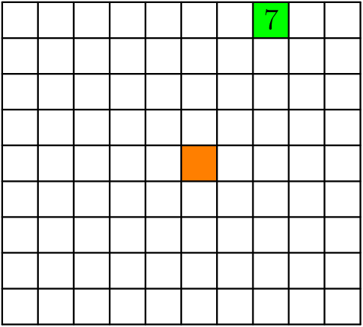
Notes:
[asy]
size(5cm);
void drawGrid(int n, real width){
for(int i=0; i<=n; ++i){
//pair X =
draw((width*i,0)--(width*i,n*width));
}
for(int i=0; i<=n; ++i){
//pair X =
draw((0,width*i)--(width*n,i*width));
}
}
pair b(real x, real y, int n, real width){
//real width = 10.0;
//int n = 8;
real newx = y;
real newy = n+1-x;
return (newx*width-width/2, newy*width-width/2);
}
void drawNumGrid(int n, real width){
drawGrid(n, width);
for(int i=1; i<=n; ++i){
for(int j=1; j<=n; ++j){
pair p = b(i, j, n, width);
string s = (string) (n*(i-1)+j);
label(s,p);
}
}
}
void drawRectGrid(int m, int n, real width){
for(int i=0; i<=m; ++i){
//pair X =
draw((width*i,0)--(width*i,n*width));
}
for(int i=0; i<=n; ++i){
//pair X =
draw((0,width*i)--(width*m,i*width));
}
}
void drawRectNumGrid(int m, int n, real width){
drawRectGrid(m,n,width);
for(int i=1; i<=n; ++i){
for(int j=1; j<=m; ++j){
pair p = b(i, j, n, width);
string s = (string) (m*(i-1)+j);
label(s,p);
}
}
}
void drawCustomNumGrid(int n, real width, int[][] labels){
drawGrid(n, width);
for(int i=0; i<=n-1; ++i){
for(int j=0; j<=n-1; ++j){
pair p = b(i+1,j+1,n, width);
string s = (string) (labels[i][j]);
label(s,p);
}
}
}
void drawCustomRectNumGrid(int m, int n, real width, int[][] labels){
drawRectGrid(m, n, width);
for(int i=0; i<=n-1; ++i){
for(int j=0; j<=m-1; ++j){
pair p = b(i+1,j+1,n, width);
string s = (string) (labels[i][j]);
label(s,p);
}
}
}
void drawRotate(pair c, int size, real width, bool ccw){
real r = (real) size;
r = r/2 * width * .9;
if(ccw){
draw(arc(c, r, 65, 125), ArcArrow);
draw(arc(c, r, 145, 215), ArcArrow);
draw(arc(c, r, 235, 305), ArcArrow);
draw(arc(c, r, 325, 360+35), ArcArrow);
}else{
draw(arc(c, r, 125, 65), ArcArrow);
draw(arc(c, r, 215, 145), ArcArrow);
draw(arc(c, r, 305, 235), ArcArrow);
draw(arc(c, r, 360+35, 325), ArcArrow);
}
}
void fillSquare(int x, int y, int n, real width, pen p){
fill(b(x-.5,y-.5,n,width)--b(x+.5,y-.5,n,width)--b(x+.5,y+.5,n,width)--b(x-.5,y+.5,n,width)--cycle,p);
}
fillSquare(5,6,9,10,orange);
fillSquare(1,8,9,10,green);
drawRectGrid(10, 9, 10);
label("$7$",b(1,8,9,10));
[/asy]

Slide 30
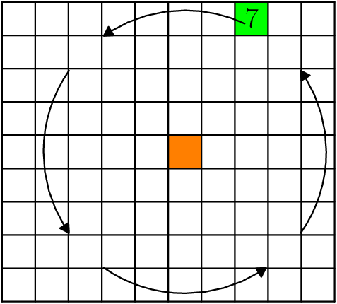
Notes:
[asy]
size(5cm);
void drawGrid(int n, real width){
for(int i=0; i<=n; ++i){
//pair X =
draw((width*i,0)--(width*i,n*width));
}
for(int i=0; i<=n; ++i){
//pair X =
draw((0,width*i)--(width*n,i*width));
}
}
pair b(real x, real y, int n, real width){
//real width = 10.0;
//int n = 8;
real newx = y;
real newy = n+1-x;
return (newx*width-width/2, newy*width-width/2);
}
void drawNumGrid(int n, real width){
drawGrid(n, width);
for(int i=1; i<=n; ++i){
for(int j=1; j<=n; ++j){
pair p = b(i, j, n, width);
string s = (string) (n*(i-1)+j);
label(s,p);
}
}
}
void drawRectGrid(int m, int n, real width){
for(int i=0; i<=m; ++i){
//pair X =
draw((width*i,0)--(width*i,n*width));
}
for(int i=0; i<=n; ++i){
//pair X =
draw((0,width*i)--(width*m,i*width));
}
}
void drawRectNumGrid(int m, int n, real width){
drawRectGrid(m,n,width);
for(int i=1; i<=n; ++i){
for(int j=1; j<=m; ++j){
pair p = b(i, j, n, width);
string s = (string) (m*(i-1)+j);
label(s,p);
}
}
}
void drawCustomNumGrid(int n, real width, int[][] labels){
drawGrid(n, width);
for(int i=0; i<=n-1; ++i){
for(int j=0; j<=n-1; ++j){
pair p = b(i+1,j+1,n, width);
string s = (string) (labels[i][j]);
label(s,p);
}
}
}
void drawCustomRectNumGrid(int m, int n, real width, int[][] labels){
drawRectGrid(m, n, width);
for(int i=0; i<=n-1; ++i){
for(int j=0; j<=m-1; ++j){
pair p = b(i+1,j+1,n, width);
string s = (string) (labels[i][j]);
label(s,p);
}
}
}
void drawRotate(pair c, int size, real width, bool ccw){
real r = (real) size;
r = r/2 * width * .9;
if(ccw){
draw(arc(c, r, 65, 125), ArcArrow);
draw(arc(c, r, 145, 215), ArcArrow);
draw(arc(c, r, 235, 305), ArcArrow);
draw(arc(c, r, 325, 360+35), ArcArrow);
}else{
draw(arc(c, r, 125, 65), ArcArrow);
draw(arc(c, r, 215, 145), ArcArrow);
draw(arc(c, r, 305, 235), ArcArrow);
draw(arc(c, r, 360+35, 325), ArcArrow);
}
}
void fillSquare(int x, int y, int n, real width, pen p){
fill(b(x-.5,y-.5,n,width)--b(x+.5,y-.5,n,width)--b(x+.5,y+.5,n,width)--b(x-.5,y+.5,n,width)--cycle,p);
}
fillSquare(5,6,9,10,orange);
fillSquare(1,8,9,10,green);
drawRectGrid(10, 9, 10);
label("$7$",b(1,8,9,10));
drawRotate(b(5,6,9,10),9,10.5,true); //+.5 is an adjustment
[/asy]

Slide 31
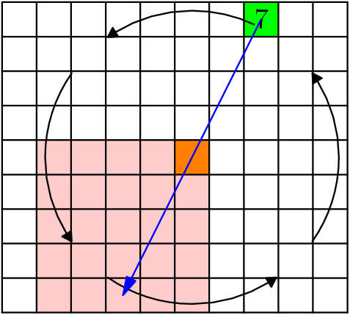
Notes:
[asy]
size(5cm);
void drawGrid(int n, real width){
for(int i=0; i<=n; ++i){
//pair X =
draw((width*i,0)--(width*i,n*width));
}
for(int i=0; i<=n; ++i){
//pair X =
draw((0,width*i)--(width*n,i*width));
}
}
pair b(real x, real y, int n, real width){
//real width = 10.0;
//int n = 8;
real newx = y;
real newy = n+1-x;
return (newx*width-width/2, newy*width-width/2);
}
void drawNumGrid(int n, real width){
drawGrid(n, width);
for(int i=1; i<=n; ++i){
for(int j=1; j<=n; ++j){
pair p = b(i, j, n, width);
string s = (string) (n*(i-1)+j);
label(s,p);
}
}
}
void drawRectGrid(int m, int n, real width){
for(int i=0; i<=m; ++i){
//pair X =
draw((width*i,0)--(width*i,n*width));
}
for(int i=0; i<=n; ++i){
//pair X =
draw((0,width*i)--(width*m,i*width));
}
}
void drawRectNumGrid(int m, int n, real width){
drawRectGrid(m,n,width);
for(int i=1; i<=n; ++i){
for(int j=1; j<=m; ++j){
pair p = b(i, j, n, width);
string s = (string) (m*(i-1)+j);
label(s,p);
}
}
}
void drawCustomNumGrid(int n, real width, int[][] labels){
drawGrid(n, width);
for(int i=0; i<=n-1; ++i){
for(int j=0; j<=n-1; ++j){
pair p = b(i+1,j+1,n, width);
string s = (string) (labels[i][j]);
label(s,p);
}
}
}
void drawCustomRectNumGrid(int m, int n, real width, int[][] labels){
drawRectGrid(m, n, width);
for(int i=0; i<=n-1; ++i){
for(int j=0; j<=m-1; ++j){
pair p = b(i+1,j+1,n, width);
string s = (string) (labels[i][j]);
label(s,p);
}
}
}
void drawRotate(pair c, int size, real width, bool ccw){
real r = (real) size;
r = r/2 * width * .9;
if(ccw){
draw(arc(c, r, 65, 125), ArcArrow);
draw(arc(c, r, 145, 215), ArcArrow);
draw(arc(c, r, 235, 305), ArcArrow);
draw(arc(c, r, 325, 360+35), ArcArrow);
}else{
draw(arc(c, r, 125, 65), ArcArrow);
draw(arc(c, r, 215, 145), ArcArrow);
draw(arc(c, r, 305, 235), ArcArrow);
draw(arc(c, r, 360+35, 325), ArcArrow);
}
}
void fillSquare(int x, int y, int n, real width, pen p){
fill(b(x-.5,y-.5,n,width)--b(x+.5,y-.5,n,width)--b(x+.5,y+.5,n,width)--b(x-.5,y+.5,n,width)--cycle,p);
}
fill(b(4.5,1.5,9,10)--b(9.5,1.5,9,10)--b(9.5,6.5,9,10)--b(4.5,6.5,9,10)--cycle,rgb(1,.8,.8));
fillSquare(5,6,9,10,orange);
fillSquare(1,8,9,10,green);
drawRectGrid(10, 9, 10);
label("$7$",b(1,8,9,10));
drawRotate(b(5,6,9,10),9,10.5,true); //+.5 is an adjustment
draw(b(1,8,9,10)--b(9,4,9,10),blue,Arrow);
[/asy]

Slide 32
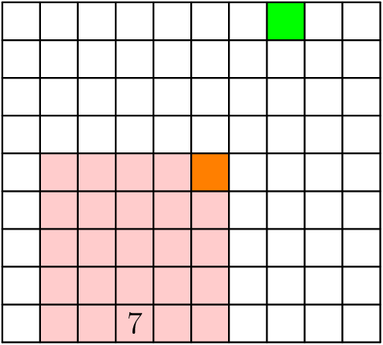
Notes:
[asy]
size(5cm);
void drawGrid(int n, real width){
for(int i=0; i<=n; ++i){
//pair X =
draw((width*i,0)--(width*i,n*width));
}
for(int i=0; i<=n; ++i){
//pair X =
draw((0,width*i)--(width*n,i*width));
}
}
pair b(real x, real y, int n, real width){
//real width = 10.0;
//int n = 8;
real newx = y;
real newy = n+1-x;
return (newx*width-width/2, newy*width-width/2);
}
void drawNumGrid(int n, real width){
drawGrid(n, width);
for(int i=1; i<=n; ++i){
for(int j=1; j<=n; ++j){
pair p = b(i, j, n, width);
string s = (string) (n*(i-1)+j);
label(s,p);
}
}
}
void drawRectGrid(int m, int n, real width){
for(int i=0; i<=m; ++i){
//pair X =
draw((width*i,0)--(width*i,n*width));
}
for(int i=0; i<=n; ++i){
//pair X =
draw((0,width*i)--(width*m,i*width));
}
}
void drawRectNumGrid(int m, int n, real width){
drawRectGrid(m,n,width);
for(int i=1; i<=n; ++i){
for(int j=1; j<=m; ++j){
pair p = b(i, j, n, width);
string s = (string) (m*(i-1)+j);
label(s,p);
}
}
}
void drawCustomNumGrid(int n, real width, int[][] labels){
drawGrid(n, width);
for(int i=0; i<=n-1; ++i){
for(int j=0; j<=n-1; ++j){
pair p = b(i+1,j+1,n, width);
string s = (string) (labels[i][j]);
label(s,p);
}
}
}
void drawCustomRectNumGrid(int m, int n, real width, int[][] labels){
drawRectGrid(m, n, width);
for(int i=0; i<=n-1; ++i){
for(int j=0; j<=m-1; ++j){
pair p = b(i+1,j+1,n, width);
string s = (string) (labels[i][j]);
label(s,p);
}
}
}
void drawRotate(pair c, int size, real width, bool ccw){
real r = (real) size;
r = r/2 * width * .9;
if(ccw){
draw(arc(c, r, 65, 125), ArcArrow);
draw(arc(c, r, 145, 215), ArcArrow);
draw(arc(c, r, 235, 305), ArcArrow);
draw(arc(c, r, 325, 360+35), ArcArrow);
}else{
draw(arc(c, r, 125, 65), ArcArrow);
draw(arc(c, r, 215, 145), ArcArrow);
draw(arc(c, r, 305, 235), ArcArrow);
draw(arc(c, r, 360+35, 325), ArcArrow);
}
}
void fillSquare(int x, int y, int n, real width, pen p){
fill(b(x-.5,y-.5,n,width)--b(x+.5,y-.5,n,width)--b(x+.5,y+.5,n,width)--b(x-.5,y+.5,n,width)--cycle,p);
}
fill(b(4.5,1.5,9,10)--b(9.5,1.5,9,10)--b(9.5,6.5,9,10)--b(4.5,6.5,9,10)--cycle,rgb(1,.8,.8));
fillSquare(5,6,9,10,orange);
fillSquare(1,8,9,10,green);
drawRectGrid(10, 9, 10);
label("$7$",b(9,4,9,10));
[/asy]

Slide 33
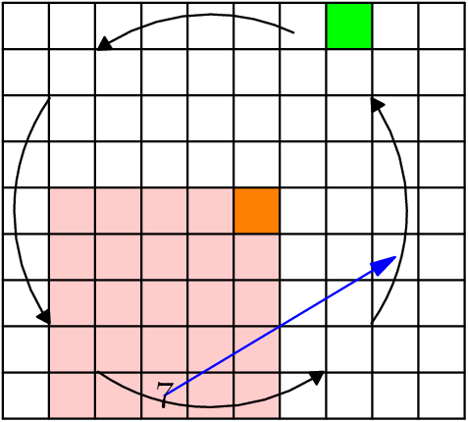

Slide 34
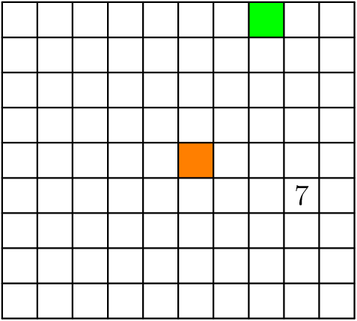

Slide 35
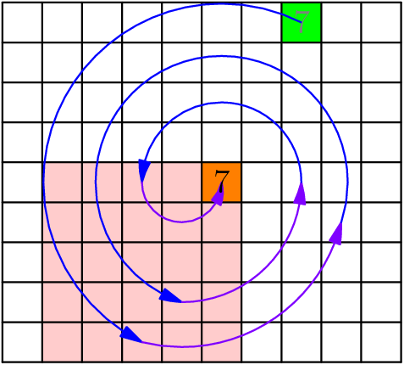

Slide 36
Spiral – Bring Any Number to the Center
Bring the number to the lower-left quadrant of the Y rotating block.
Execute X.
Repeat until number reaches center of rotation of Y.
How do we know this algorithm works? Why will the number eventually reach the center?
  Key idea: The number’s distance to the center of rotation of Y decreases with every iteration of Spiral. In other words, this distance is a strictly decreasing monovariant.
    How can we prove this?

Slide 38
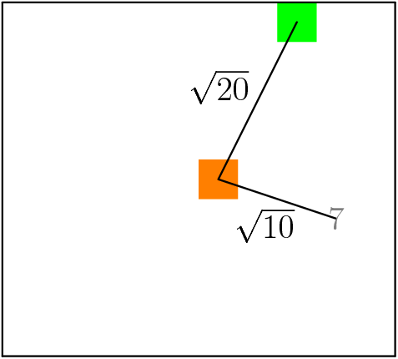
Notes:
fillSquare(5,6,9,10,orange);
fillSquare(1,8,9,10,green);
draw((10*0,0)--(10*0,9*10));
draw((10*10,0)--(10*10,9*10));
draw((0,10*0)--(10*10,0*10));
draw((0,10*9)--(10*10,9*10));
label("$7$",b(6,9,9,10),gray(0.5));
draw(b(1,8,9,10)--b(5,6,9,10));
label("$\sqrt{20}$",b(1,8,9,10)--b(5,6,9,10));
draw(b(6,9,9,10)--b(5,6,9,10));
label("$\sqrt{10}$",b(5,6,9,10)--b(6,9,9,10));

Slide 39
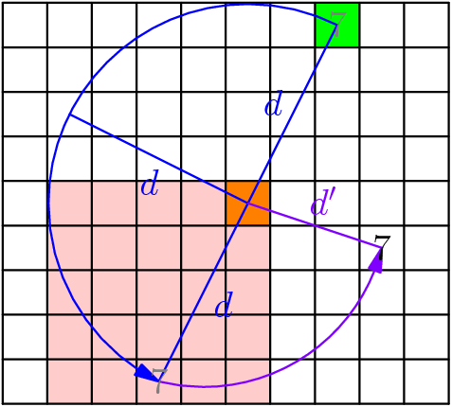

Slide 40
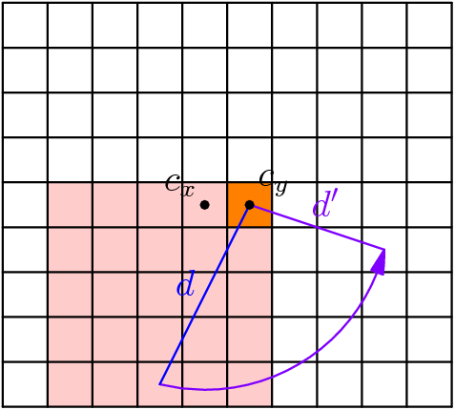

Slide 41
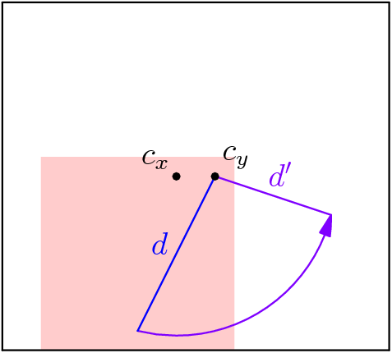
Notes:
[asy]
size(5cm);
void drawGrid(int n, real width){
for(int i=0; i<=n; ++i){
//pair X =
draw((width*i,0)--(width*i,n*width));
}
for(int i=0; i<=n; ++i){
//pair X =
draw((0,width*i)--(width*n,i*width));
}
}
pair b(real x, real y, int n, real width){
//real width = 10.0;
//int n = 8;
real newx = y;
real newy = n+1-x;
return (newx*width-width/2, newy*width-width/2);
}
void drawNumGrid(int n, real width){
drawGrid(n, width);
for(int i=1; i<=n; ++i){
for(int j=1; j<=n; ++j){
pair p = b(i, j, n, width);
string s = (string) (n*(i-1)+j);
label(s,p);
}
}
}
void drawRectGrid(int m, int n, real width){
for(int i=0; i<=m; ++i){
//pair X =
draw((width*i,0)--(width*i,n*width));
}
for(int i=0; i<=n; ++i){
//pair X =
draw((0,width*i)--(width*m,i*width));
}
}
void drawRectNumGrid(int m, int n, real width){
drawRectGrid(m,n,width);
for(int i=1; i<=n; ++i){
for(int j=1; j<=m; ++j){
pair p = b(i, j, n, width);
string s = (string) (m*(i-1)+j);
label(s,p);
}
}
}
void drawCustomNumGrid(int n, real width, int[][] labels){
drawGrid(n, width);
for(int i=0; i<=n-1; ++i){
for(int j=0; j<=n-1; ++j){
pair p = b(i+1,j+1,n, width);
string s = (string) (labels[i][j]);
label(s,p);
}
}
}
void drawCustomRectNumGrid(int m, int n, real width, int[][] labels){
drawRectGrid(m, n, width);
for(int i=0; i<=n-1; ++i){
for(int j=0; j<=m-1; ++j){
pair p = b(i+1,j+1,n, width);
string s = (string) (labels[i][j]);
label(s,p);
}
}
}
void drawRotate(pair c, int size, real width, bool ccw){
real r = (real) size;
r = r/2 * width * .9;
if(ccw){
draw(arc(c, r, 65, 125), ArcArrow);
draw(arc(c, r, 145, 215), ArcArrow);
draw(arc(c, r, 235, 305), ArcArrow);
draw(arc(c, r, 325, 360+35), ArcArrow);
}else{
draw(arc(c, r, 125, 65), ArcArrow);
draw(arc(c, r, 215, 145), ArcArrow);
draw(arc(c, r, 305, 235), ArcArrow);
draw(arc(c, r, 360+35, 325), ArcArrow);
}
}
void fillSquare(int x, int y, int n, real width, pen p){
fill(b(x-.5,y-.5,n,width)--b(x+.5,y-.5,n,width)--b(x+.5,y+.5,n,width)--b(x-.5,y+.5,n,width)--cycle,p);
}
fill(b(4.5,1.5,9,10)--b(9.5,1.5,9,10)--b(9.5,6.5,9,10)--b(4.5,6.5,9,10)--cycle,rgb(1,.8,.8));
draw((10*0,0)--(10*0,9*10));
draw((10*10,0)--(10*10,9*10));
draw((0,10*0)--(10*10,0*10));
draw((0,10*9)--(10*10,9*10));
draw(arc(b(5,5,9,10),sqrt(17)*10,aTan(4)+180,aTan(4)+270),purple,Arrow);
draw(b(5,6,9,10)--b(9,4,9,10),blue);
label("$d$",b(5,6,9,10)--b(9,4,9,10),blue);
draw(b(5,6,9,10)--b(6,9,9,10),purple);
label("$d^\prime$",b(6,9,9,10)--b(5,6,9,10),purple);
dot("$c_x$",b(5,5,9,10),NW);
dot("$c_y$",b(5,6,9,10),NE);
[/asy]

Slide 42
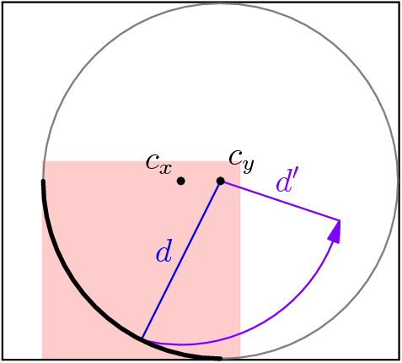

Slide 43
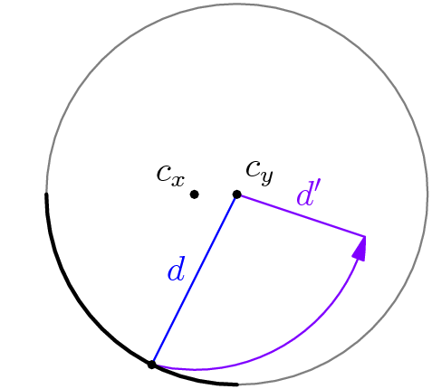

Slide 44
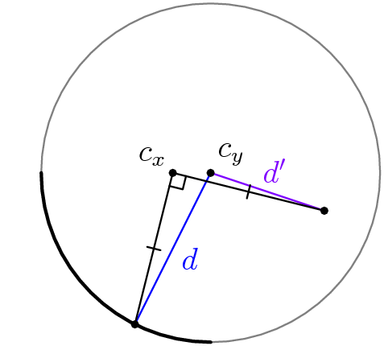

Slide 45
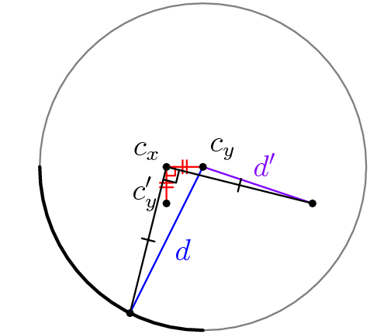
Notes:
[asy]
size(5cm);
import olympiad;
void drawGrid(int n, real width){
for(int i=0; i<=n; ++i){
//pair X =
draw((width*i,0)--(width*i,n*width));
}
for(int i=0; i<=n; ++i){
//pair X =
draw((0,width*i)--(width*n,i*width));
}
}
pair b(real x, real y, int n, real width){
//real width = 10.0;
//int n = 8;
real newx = y;
real newy = n+1-x;
return (newx*width-width/2, newy*width-width/2);
}
void drawNumGrid(int n, real width){
drawGrid(n, width);
for(int i=1; i<=n; ++i){
for(int j=1; j<=n; ++j){
pair p = b(i, j, n, width);
string s = (string) (n*(i-1)+j);
label(s,p);
}
}
}
void drawRectGrid(int m, int n, real width){
for(int i=0; i<=m; ++i){
//pair X =
draw((width*i,0)--(width*i,n*width));
}
for(int i=0; i<=n; ++i){
//pair X =
draw((0,width*i)--(width*m,i*width));
}
}
void drawRectNumGrid(int m, int n, real width){
drawRectGrid(m,n,width);
for(int i=1; i<=n; ++i){
for(int j=1; j<=m; ++j){
pair p = b(i, j, n, width);
string s = (string) (m*(i-1)+j);
label(s,p);
}
}
}
void drawCustomNumGrid(int n, real width, int[][] labels){
drawGrid(n, width);
for(int i=0; i<=n-1; ++i){
for(int j=0; j<=n-1; ++j){
pair p = b(i+1,j+1,n, width);
string s = (string) (labels[i][j]);
label(s,p);
}
}
}
void drawCustomRectNumGrid(int m, int n, real width, int[][] labels){
drawRectGrid(m, n, width);
for(int i=0; i<=n-1; ++i){
for(int j=0; j<=m-1; ++j){
pair p = b(i+1,j+1,n, width);
string s = (string) (labels[i][j]);
label(s,p);
}
}
}
void drawRotate(pair c, int size, real width, bool ccw){
real r = (real) size;
r = r/2 * width * .9;
if(ccw){
draw(arc(c, r, 65, 125), ArcArrow);
draw(arc(c, r, 145, 215), ArcArrow);
draw(arc(c, r, 235, 305), ArcArrow);
draw(arc(c, r, 325, 360+35), ArcArrow);
}else{
draw(arc(c, r, 125, 65), ArcArrow);
draw(arc(c, r, 215, 145), ArcArrow);
draw(arc(c, r, 305, 235), ArcArrow);
draw(arc(c, r, 360+35, 325), ArcArrow);
}
}
void fillSquare(int x, int y, int n, real width, pen p){
fill(b(x-.5,y-.5,n,width)--b(x+.5,y-.5,n,width)--b(x+.5,y+.5,n,width)--b(x-.5,y+.5,n,width)--cycle,p);
}
draw((0,0)--(0,90)--(100,90)--(100,0)--(0,0),invisible);
draw(b(6,5,9,10)--b(5,5,9,10)--b(5,6,9,10),linewidth(0.5)+red);
draw(rightanglemark(b(6,5,9,10),b(5,5,9,10),b(5,6,9,10),s=80),red);
add(pathticks(b(6,5,9,10)--b(5,5,9,10),n=2,spacing=40,s=120,red));
add(pathticks(b(5,5,9,10)--b(5,6,9,10),n=2,spacing=40,s=120,red));
draw(b(5,6,9,10)--b(9,4,9,10),blue);
label("$d$",b(9,4,9,10)--b(5,6,9,10),blue);
draw(b(5,6,9,10)--b(6,9,9,10),purple);
label("$d^\prime$",b(6,9,9,10)--b(5,6,9,10),purple);
dot("$c_x$",b(5,5,9,10),NW);
dot("$c_y$",b(5,6,9,10),NE);
draw(circle(b(5,6,9,10),10*sqrt(20)),gray(0.5));
draw(arc(b(5,6,9,10),10*sqrt(20),180,270),linewidth(1.25));
dot(b(9,4,9,10));
dot(b(6,9,9,10));
draw(b(9,4,9,10)--b(5,5,9,10)--b(6,9,9,10));
draw(rightanglemark(b(9,4,9,10),b(5,5,9,10),b(6,9,9,10),120));
add(pathticks(b(9,4,9,10)--b(5,5,9,10),s=120));
add(pathticks(b(5,5,9,10)--b(6,9,9,10),s=120));
dot("$c_y^\prime$",b(6,5,9,10),W/dir(20));
[/asy]

Slide 46
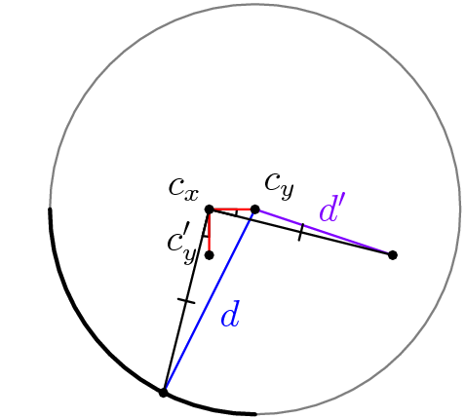

Slide 47
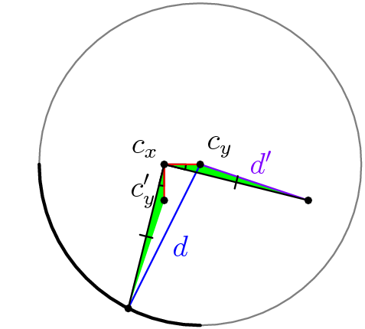

Slide 48
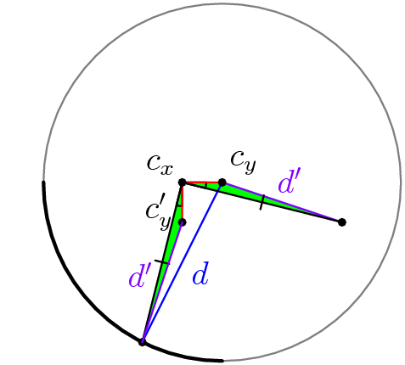
Notes:
[asy]
size(5cm);
import olympiad;
void drawGrid(int n, real width){
for(int i=0; i<=n; ++i){
//pair X =
draw((width*i,0)--(width*i,n*width));
}
for(int i=0; i<=n; ++i){
//pair X =
draw((0,width*i)--(width*n,i*width));
}
}
pair b(real x, real y, int n, real width){
//real width = 10.0;
//int n = 8;
real newx = y;
real newy = n+1-x;
return (newx*width-width/2, newy*width-width/2);
}
void drawNumGrid(int n, real width){
drawGrid(n, width);
for(int i=1; i<=n; ++i){
for(int j=1; j<=n; ++j){
pair p = b(i, j, n, width);
string s = (string) (n*(i-1)+j);
label(s,p);
}
}
}
void drawRectGrid(int m, int n, real width){
for(int i=0; i<=m; ++i){
//pair X =
draw((width*i,0)--(width*i,n*width));
}
for(int i=0; i<=n; ++i){
//pair X =
draw((0,width*i)--(width*m,i*width));
}
}
void drawRectNumGrid(int m, int n, real width){
drawRectGrid(m,n,width);
for(int i=1; i<=n; ++i){
for(int j=1; j<=m; ++j){
pair p = b(i, j, n, width);
string s = (string) (m*(i-1)+j);
label(s,p);
}
}
}
void drawCustomNumGrid(int n, real width, int[][] labels){
drawGrid(n, width);
for(int i=0; i<=n-1; ++i){
for(int j=0; j<=n-1; ++j){
pair p = b(i+1,j+1,n, width);
string s = (string) (labels[i][j]);
label(s,p);
}
}
}
void drawCustomRectNumGrid(int m, int n, real width, int[][] labels){
drawRectGrid(m, n, width);
for(int i=0; i<=n-1; ++i){
for(int j=0; j<=m-1; ++j){
pair p = b(i+1,j+1,n, width);
string s = (string) (labels[i][j]);
label(s,p);
}
}
}
void drawRotate(pair c, int size, real width, bool ccw){
real r = (real) size;
r = r/2 * width * .9;
if(ccw){
draw(arc(c, r, 65, 125), ArcArrow);
draw(arc(c, r, 145, 215), ArcArrow);
draw(arc(c, r, 235, 305), ArcArrow);
draw(arc(c, r, 325, 360+35), ArcArrow);
}else{
draw(arc(c, r, 125, 65), ArcArrow);
draw(arc(c, r, 215, 145), ArcArrow);
draw(arc(c, r, 305, 235), ArcArrow);
draw(arc(c, r, 360+35, 325), ArcArrow);
}
}
void fillSquare(int x, int y, int n, real width, pen p){
fill(b(x-.5,y-.5,n,width)--b(x+.5,y-.5,n,width)--b(x+.5,y+.5,n,width)--b(x-.5,y+.5,n,width)--cycle,p);
}
draw((0,0)--(0,90)--(100,90)--(100,0)--(0,0),invisible);
fill(b(9,4,9,10)--b(6,5,9,10)--b(5,5,9,10)--cycle,green);
fill(b(5,6,9,10)--b(5,5,9,10)--b(6,9,9,10)--cycle,green);
draw(anglemark(b(9,4,9,10),b(5,5,9,10),b(6,5,9,10),200));
draw(anglemark(b(6,9,9,10),b(5,5,9,10),b(5,6,9,10),200));
draw(b(6,5,9,10)--b(5,5,9,10)--b(5,6,9,10),linewidth(0.5)+red);
draw(b(5,6,9,10)--b(9,4,9,10),blue);
label("$d$",b(9,4,9,10)--b(5,6,9,10),blue);
draw(b(5,6,9,10)--b(6,9,9,10),purple);
label("$d^\prime$",b(6,9,9,10)--b(5,6,9,10),purple);
dot("$c_x$",b(5,5,9,10),NW);
dot("$c_y$",b(5,6,9,10),NE);
draw(circle(b(5,6,9,10),10*sqrt(20)),gray(0.5));
draw(arc(b(5,6,9,10),10*sqrt(20),180,270),linewidth(1.25));
dot(b(9,4,9,10));
dot(b(6,9,9,10));
draw(b(9,4,9,10)--b(5,5,9,10)--b(6,9,9,10));
add(pathticks(b(9,4,9,10)--b(5,5,9,10),s=120));
add(pathticks(b(5,5,9,10)--b(6,9,9,10),s=120));
dot("$c_y^\prime$",b(6,5,9,10),W/dir(20));
draw(b(9,4,9,10)--b(6,5,9,10),purple);
label("$d^\prime$",b(6,5,9,10)--b(9,4,9,10),purple);
[/asy]

Slide 49
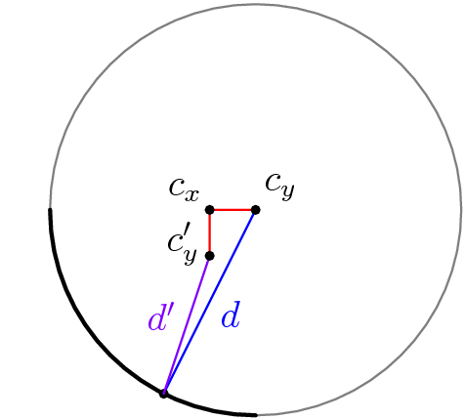

Slide 50
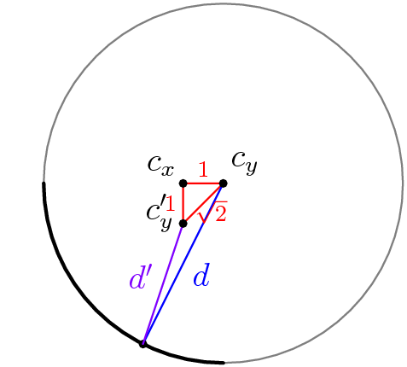
Notes:
[asy]
size(5cm);
import olympiad;
void drawGrid(int n, real width){
for(int i=0; i<=n; ++i){
//pair X =
draw((width*i,0)--(width*i,n*width));
}
for(int i=0; i<=n; ++i){
//pair X =
draw((0,width*i)--(width*n,i*width));
}
}
pair b(real x, real y, int n, real width){
//real width = 10.0;
//int n = 8;
real newx = y;
real newy = n+1-x;
return (newx*width-width/2, newy*width-width/2);
}
void drawNumGrid(int n, real width){
drawGrid(n, width);
for(int i=1; i<=n; ++i){
for(int j=1; j<=n; ++j){
pair p = b(i, j, n, width);
string s = (string) (n*(i-1)+j);
label(s,p);
}
}
}
void drawRectGrid(int m, int n, real width){
for(int i=0; i<=m; ++i){
//pair X =
draw((width*i,0)--(width*i,n*width));
}
for(int i=0; i<=n; ++i){
//pair X =
draw((0,width*i)--(width*m,i*width));
}
}
void drawRectNumGrid(int m, int n, real width){
drawRectGrid(m,n,width);
for(int i=1; i<=n; ++i){
for(int j=1; j<=m; ++j){
pair p = b(i, j, n, width);
string s = (string) (m*(i-1)+j);
label(s,p);
}
}
}
void drawCustomNumGrid(int n, real width, int[][] labels){
drawGrid(n, width);
for(int i=0; i<=n-1; ++i){
for(int j=0; j<=n-1; ++j){
pair p = b(i+1,j+1,n, width);
string s = (string) (labels[i][j]);
label(s,p);
}
}
}
void drawCustomRectNumGrid(int m, int n, real width, int[][] labels){
drawRectGrid(m, n, width);
for(int i=0; i<=n-1; ++i){
for(int j=0; j<=m-1; ++j){
pair p = b(i+1,j+1,n, width);
string s = (string) (labels[i][j]);
label(s,p);
}
}
}
void drawRotate(pair c, int size, real width, bool ccw){
real r = (real) size;
r = r/2 * width * .9;
if(ccw){
draw(arc(c, r, 65, 125), ArcArrow);
draw(arc(c, r, 145, 215), ArcArrow);
draw(arc(c, r, 235, 305), ArcArrow);
draw(arc(c, r, 325, 360+35), ArcArrow);
}else{
draw(arc(c, r, 125, 65), ArcArrow);
draw(arc(c, r, 215, 145), ArcArrow);
draw(arc(c, r, 305, 235), ArcArrow);
draw(arc(c, r, 360+35, 325), ArcArrow);
}
}
void fillSquare(int x, int y, int n, real width, pen p){
fill(b(x-.5,y-.5,n,width)--b(x+.5,y-.5,n,width)--b(x+.5,y+.5,n,width)--b(x-.5,y+.5,n,width)--cycle,p);
}
draw((0,0)--(0,90)--(100,90)--(100,0)--(0,0),invisible);
draw(b(6,5,9,10)--b(5,5,9,10)--b(5,6,9,10)--cycle,linewidth(0.5)+red);
draw(b(5,6,9,10)--b(9,4,9,10),blue);
label("$d$",b(9,4,9,10)--b(5,6,9,10),blue);
dot("$c_x$",b(5,5,9,10),NW);
dot("$c_y$",b(5,6,9,10),NE);
draw(circle(b(5,6,9,10),10*sqrt(20)),gray(0.5));
draw(arc(b(5,6,9,10),10*sqrt(20),180,270),linewidth(1.25));
dot(b(9,4,9,10));
draw(b(9,4,9,10)--b(6,5,9,10),purple);
label("$d^\prime$",b(6,5,9,10)--b(9,4,9,10),purple);
dot("$c_y^\prime$",b(6,5,9,10),W/dir(20));
label("$1$",b(5,5,9,10)--b(5,6,9,10),N,red+fontsize(8pt));
label("$1$",b(5,5,9,10)--b(6,5,9,10),W,red+fontsize(8pt));
label(shift(-5/2-.8,3/2)*"$\sqrt{2}$",b(5,6,9,10)--b(6,5,9,10),.2*SE,red+fontsize(8pt));
[/asy]

Slide 51
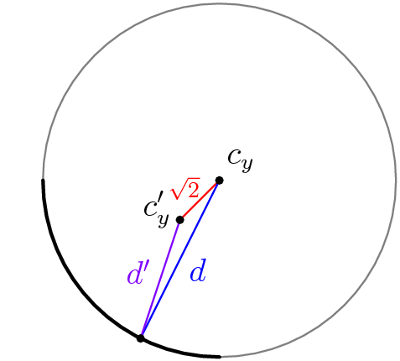
Notes:
[asy]
size(5cm);
import olympiad;
void drawGrid(int n, real width){
for(int i=0; i<=n; ++i){
//pair X =
draw((width*i,0)--(width*i,n*width));
}
for(int i=0; i<=n; ++i){
//pair X =
draw((0,width*i)--(width*n,i*width));
}
}
pair b(real x, real y, int n, real width){
//real width = 10.0;
//int n = 8;
real newx = y;
real newy = n+1-x;
return (newx*width-width/2, newy*width-width/2);
}
void drawNumGrid(int n, real width){
drawGrid(n, width);
for(int i=1; i<=n; ++i){
for(int j=1; j<=n; ++j){
pair p = b(i, j, n, width);
string s = (string) (n*(i-1)+j);
label(s,p);
}
}
}
void drawRectGrid(int m, int n, real width){
for(int i=0; i<=m; ++i){
//pair X =
draw((width*i,0)--(width*i,n*width));
}
for(int i=0; i<=n; ++i){
//pair X =
draw((0,width*i)--(width*m,i*width));
}
}
void drawRectNumGrid(int m, int n, real width){
drawRectGrid(m,n,width);
for(int i=1; i<=n; ++i){
for(int j=1; j<=m; ++j){
pair p = b(i, j, n, width);
string s = (string) (m*(i-1)+j);
label(s,p);
}
}
}
void drawCustomNumGrid(int n, real width, int[][] labels){
drawGrid(n, width);
for(int i=0; i<=n-1; ++i){
for(int j=0; j<=n-1; ++j){
pair p = b(i+1,j+1,n, width);
string s = (string) (labels[i][j]);
label(s,p);
}
}
}
void drawCustomRectNumGrid(int m, int n, real width, int[][] labels){
drawRectGrid(m, n, width);
for(int i=0; i<=n-1; ++i){
for(int j=0; j<=m-1; ++j){
pair p = b(i+1,j+1,n, width);
string s = (string) (labels[i][j]);
label(s,p);
}
}
}
void drawRotate(pair c, int size, real width, bool ccw){
real r = (real) size;
r = r/2 * width * .9;
if(ccw){
draw(arc(c, r, 65, 125), ArcArrow);
draw(arc(c, r, 145, 215), ArcArrow);
draw(arc(c, r, 235, 305), ArcArrow);
draw(arc(c, r, 325, 360+35), ArcArrow);
}else{
draw(arc(c, r, 125, 65), ArcArrow);
draw(arc(c, r, 215, 145), ArcArrow);
draw(arc(c, r, 305, 235), ArcArrow);
draw(arc(c, r, 360+35, 325), ArcArrow);
}
}
void fillSquare(int x, int y, int n, real width, pen p){
fill(b(x-.5,y-.5,n,width)--b(x+.5,y-.5,n,width)--b(x+.5,y+.5,n,width)--b(x-.5,y+.5,n,width)--cycle,p);
}
draw((0,0)--(0,90)--(100,90)--(100,0)--(0,0),invisible);
draw(b(6,5,9,10)--b(5,6,9,10),linewidth(0.5)+red);
draw(b(5,6,9,10)--b(9,4,9,10),blue);
label("$d$",b(9,4,9,10)--b(5,6,9,10),blue);
draw(circle(b(5,6,9,10),10*sqrt(20)),gray(0.5));
draw(arc(b(5,6,9,10),10*sqrt(20),180,270),linewidth(1.25));
draw(b(9,4,9,10)--b(6,5,9,10),purple);
label("$d^\prime$",b(6,5,9,10)--b(9,4,9,10),purple);
label(shift(1.6,-1.6)*"$\sqrt{2}$",b(5,6,9,10)--b(6,5,9,10),NW,red+fontsize(8pt));
dot("$c_y^\prime$",b(6,5,9,10),W/dir(20));
dot("$c_y$",b(5,6,9,10),NE);
dot(b(9,4,9,10));
[/asy]

Slide 52
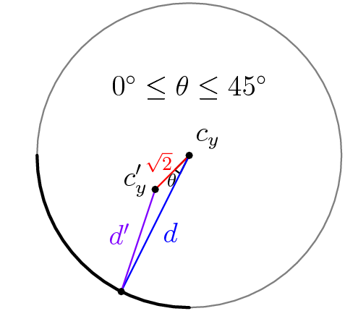
Notes:
[asy]
size(5cm);
import olympiad;
void drawGrid(int n, real width){
for(int i=0; i<=n; ++i){
//pair X =
draw((width*i,0)--(width*i,n*width));
}
for(int i=0; i<=n; ++i){
//pair X =
draw((0,width*i)--(width*n,i*width));
}
}
pair b(real x, real y, int n, real width){
//real width = 10.0;
//int n = 8;
real newx = y;
real newy = n+1-x;
return (newx*width-width/2, newy*width-width/2);
}
void drawNumGrid(int n, real width){
drawGrid(n, width);
for(int i=1; i<=n; ++i){
for(int j=1; j<=n; ++j){
pair p = b(i, j, n, width);
string s = (string) (n*(i-1)+j);
label(s,p);
}
}
}
void drawRectGrid(int m, int n, real width){
for(int i=0; i<=m; ++i){
//pair X =
draw((width*i,0)--(width*i,n*width));
}
for(int i=0; i<=n; ++i){
//pair X =
draw((0,width*i)--(width*m,i*width));
}
}
void drawRectNumGrid(int m, int n, real width){
drawRectGrid(m,n,width);
for(int i=1; i<=n; ++i){
for(int j=1; j<=m; ++j){
pair p = b(i, j, n, width);
string s = (string) (m*(i-1)+j);
label(s,p);
}
}
}
void drawCustomNumGrid(int n, real width, int[][] labels){
drawGrid(n, width);
for(int i=0; i<=n-1; ++i){
for(int j=0; j<=n-1; ++j){
pair p = b(i+1,j+1,n, width);
string s = (string) (labels[i][j]);
label(s,p);
}
}
}
void drawCustomRectNumGrid(int m, int n, real width, int[][] labels){
drawRectGrid(m, n, width);
for(int i=0; i<=n-1; ++i){
for(int j=0; j<=m-1; ++j){
pair p = b(i+1,j+1,n, width);
string s = (string) (labels[i][j]);
label(s,p);
}
}
}
void drawRotate(pair c, int size, real width, bool ccw){
real r = (real) size;
r = r/2 * width * .9;
if(ccw){
draw(arc(c, r, 65, 125), ArcArrow);
draw(arc(c, r, 145, 215), ArcArrow);
draw(arc(c, r, 235, 305), ArcArrow);
draw(arc(c, r, 325, 360+35), ArcArrow);
}else{
draw(arc(c, r, 125, 65), ArcArrow);
draw(arc(c, r, 215, 145), ArcArrow);
draw(arc(c, r, 305, 235), ArcArrow);
draw(arc(c, r, 360+35, 325), ArcArrow);
}
}
void fillSquare(int x, int y, int n, real width, pen p){
fill(b(x-.5,y-.5,n,width)--b(x+.5,y-.5,n,width)--b(x+.5,y+.5,n,width)--b(x-.5,y+.5,n,width)--cycle,p);
}
draw((0,0)--(0,90)--(100,90)--(100,0)--(0,0),invisible);
draw(anglemark(b(6,5,9,10),b(5,6,9,10),b(9,4,9,10),200));
label(shift(-3,-4.5)*"$\theta$",anglemark(b(6,5,9,10),b(5,6,9,10),b(9,4,9,10),200),SW,fontsize(8pt));
draw(b(6,5,9,10)--b(5,6,9,10),linewidth(0.5)+red);
draw(b(5,6,9,10)--b(9,4,9,10),blue);
label("$d$",b(9,4,9,10)--b(5,6,9,10),blue);
draw(circle(b(5,6,9,10),10*sqrt(20)),gray(0.5));
draw(arc(b(5,6,9,10),10*sqrt(20),180,270),linewidth(1.25));
draw(b(9,4,9,10)--b(6,5,9,10),purple);
label("$d^\prime$",b(6,5,9,10)--b(9,4,9,10),purple);
label(shift(1.6,-1.6)*"$\sqrt{2}$",b(5,6,9,10)--b(6,5,9,10),NW,red+fontsize(8pt));
dot("$c_y^\prime$",b(6,5,9,10),W/dir(20));
dot("$c_y$",b(5,6,9,10),NE);
dot(b(9,4,9,10));
label("$0^\circ \leq \theta \leq 45^\circ$",b(3,6,9,10));
[/asy]

Slide 53
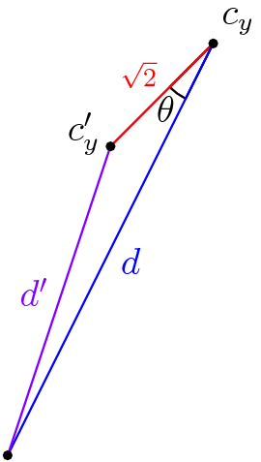
Surprise!!! – Applying Law of Cosines
To prove that the distance to the center is a strictly decreasing monovariant, we can use bounding and the Law of Cosines.
We are given:
  Indicated lengths
  0°≤ θ ≤ 45°
  d > 1 (otherwise the algorithm would have terminated already)
It suffices to show that d’ < d.
Notes:
draw(anglemark(b(6,5,9,10),b(5,6,9,10),b(9,4,9,10),200));
label(shift(-8,-11)*"$\theta$",anglemark(b(6,5,9,10),b(5,6,9,10),b(9,4,9,10),200),SW);
draw(b(6,5,9,10)--b(5,6,9,10),linewidth(0.5)+red);
draw(b(5,6,9,10)--b(9,4,9,10),blue);
label("$d$",b(9,4,9,10)--b(5,6,9,10),blue);
draw(b(9,4,9,10)--b(6,5,9,10),purple);
label("$d^\prime$",b(6,5,9,10)--b(9,4,9,10),purple);
label("$\sqrt{2}$",b(5,6,9,10)--b(6,5,9,10),NW,red+fontsize(8pt));
dot("$c_y^\prime$",b(6,5,9,10),W/dir(20));
dot("$c_y$",b(5,6,9,10),NE);
dot(b(9,4,9,10));

Slide 54
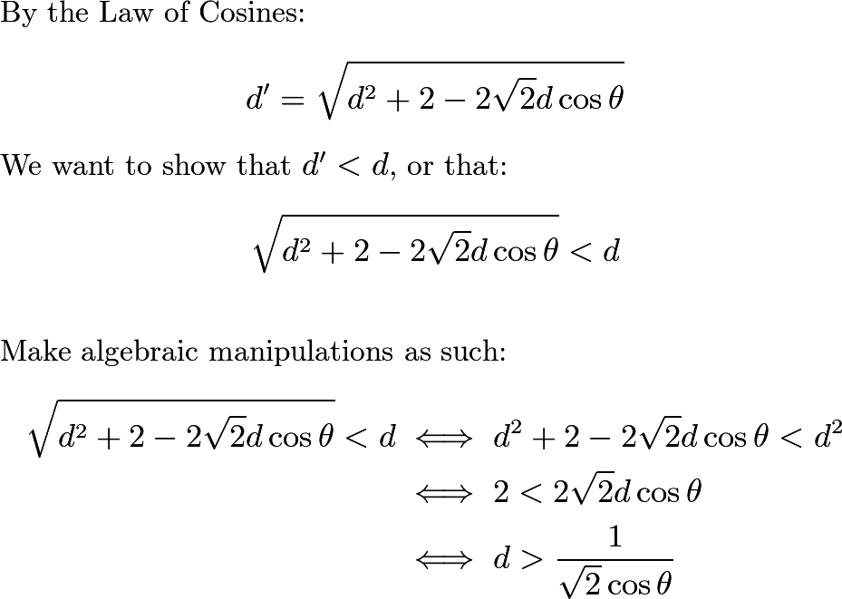

Slide 55
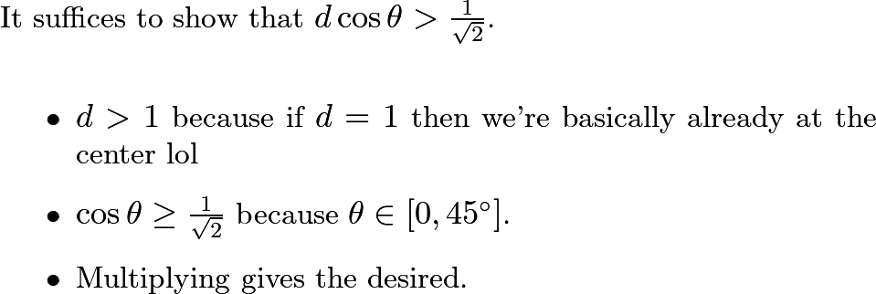
Notes:
It suffices to show that $d > \dfrac{1}{\sqrt{2}\cos\theta}$.
Since $0^\circ \leq \theta \leq 45^\circ$, the minimum value of $\cos\theta$ is $\dfrac{\sqrt{2}}{2}$, achieved when $\theta=45^\circ$. Thus:
$$\cos\theta \geq \frac{\sqrt{2}}{2}$$
This manipulates to:
$$\frac{1}{\sqrt{2}\cos\theta} \leq 1$$
But it is given that $d>1$, thus:
$$d > 1 \geq \frac{1}{\sqrt{2}\cos\theta}$$
So $d > \dfrac{1}{\sqrt{2}\cos\theta}$ by transitivity. Q.E.D.

Slide 56

Spiral Works!!!

Slide 57
Minor Tidbits
For odd n, you may have to use a horizontally flipped version of Spiral, depending on the parity of the starting square.
For even n, the center of rotation of Y is not the center of a square. Rather, it is a corner shared by four squares. Fortunately, we can work around this by instead stopping the algorithm when the desired number reaches any one of these four squares.
Don’t worry if the number starts in the first column where it can’t be moved by Y. We have ways to deal with this in the grand scheme.

Slide 58
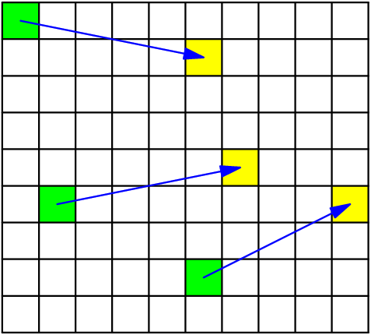
Recap
We now have an algorithm that can send any number to any square.
We need an algorithm that can send any three numbers to any three squares (Spiral-Cycle).
  It suffices to find an algorithm that can send any three numbers to three set intermediary squares.
Notes:
[asy]
size(5cm);
void drawGrid(int n, real width){
for(int i=0; i<=n; ++i){
//pair X =
draw((width*i,0)--(width*i,n*width));
}
for(int i=0; i<=n; ++i){
//pair X =
draw((0,width*i)--(width*n,i*width));
}
}
pair b(real x, real y, int n, real width){
//real width = 10.0;
//int n = 8;
real newx = y;
real newy = n+1-x;
return (newx*width-width/2, newy*width-width/2);
}
void drawNumGrid(int n, real width){
drawGrid(n, width);
for(int i=1; i<=n; ++i){
for(int j=1; j<=n; ++j){
pair p = b(i, j, n, width);
string s = (string) (n*(i-1)+j);
label(s,p);
}
}
}
void drawRectGrid(int m, int n, real width){
for(int i=0; i<=m; ++i){
//pair X =
draw((width*i,0)--(width*i,n*width));
}
for(int i=0; i<=n; ++i){
//pair X =
draw((0,width*i)--(width*m,i*width));
}
}
void drawRectNumGrid(int m, int n, real width){
drawRectGrid(m,n,width);
for(int i=1; i<=n; ++i){
for(int j=1; j<=m; ++j){
pair p = b(i, j, n, width);
string s = (string) (m*(i-1)+j);
label(s,p);
}
}
}
void drawCustomNumGrid(int n, real width, int[][] labels){
drawGrid(n, width);
for(int i=0; i<=n-1; ++i){
for(int j=0; j<=n-1; ++j){
pair p = b(i+1,j+1,n, width);
string s = (string) (labels[i][j]);
label(s,p);
}
}
}
void drawCustomRectNumGrid(int m, int n, real width, int[][] labels){
drawRectGrid(m, n, width);
for(int i=0; i<=n-1; ++i){
for(int j=0; j<=m-1; ++j){
pair p = b(i+1,j+1,n, width);
string s = (string) (labels[i][j]);
label(s,p);
}
}
}
void drawRotate(pair c, int size, real width, bool ccw){
real r = (real) size;
r = r/2 * width * .9;
if(ccw){
draw(arc(c, r, 65, 125), ArcArrow);
draw(arc(c, r, 145, 215), ArcArrow);
draw(arc(c, r, 235, 305), ArcArrow);
draw(arc(c, r, 325, 360+35), ArcArrow);
}else{
draw(arc(c, r, 125, 65), ArcArrow);
draw(arc(c, r, 215, 145), ArcArrow);
draw(arc(c, r, 305, 235), ArcArrow);
draw(arc(c, r, 360+35, 325), ArcArrow);
}
}
void fillSquare(int x, int y, int n, real width, pen p){
fill(b(x-.5,y-.5,n,width)--b(x+.5,y-.5,n,width)--b(x+.5,y+.5,n,width)--b(x-.5,y+.5,n,width)--cycle,p);
}
fillSquare(1,1,9,10,green);
fillSquare(6,2,9,10,green);
fillSquare(8,6,9,10,green);
fillSquare(2,6,9,10,yellow);
fillSquare(5,7,9,10,yellow);
fillSquare(6,10,9,10,yellow);
drawRectGrid(10, 9, 10);
draw(b(1,1,9,10)--b(2,6,9,10),blue,Arrow);
draw(b(6,2,9,10)--b(5,7,9,10),blue,Arrow);
draw(b(8,6,9,10)--b(6,10,9,10),blue,Arrow);
[/asy]

Slide 59
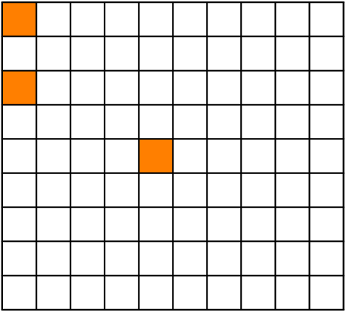
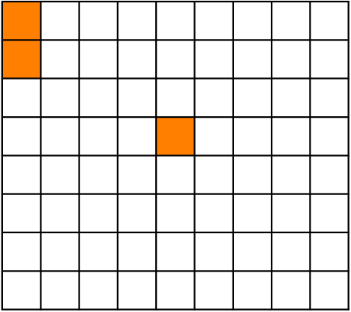
The Plan?
These three squares will be our intermediary squares:
We just need to apply Spiral three times, once for each number. But how can we maneuver each number without displacing the others?
Odd n
Even n

Slide 60
The Spiral-Cycle Algorithm
Sends any three desired numbers to three specific squares, subject to PRs.
Composed of two sub-algorithms:
  Spiral
  Cycle

Slide 61
The Spiral-Cycle Algorithm
Execute Spiral to get the first number into position.
Use an alternating Spiral to get the second number into position.
While running the third and final Spiral, ensure that each move does not displace the first two numbers.
  To free up either the X or Y rotating block, we need to use Cycle to move the first to numbers to the other side.

Slide 62


Slide 63


Slide 64


Slide 65


Slide 66


Slide 67


Slide 68


Slide 69


Slide 70


Slide 71


Slide 72


Slide 73


Slide 74


Slide 75


Slide 76


Slide 77


Slide 78


Slide 79


Slide 80


Slide 81


Slide 82


Slide 83


Slide 84


Slide 85


Slide 86


Slide 87
The General 3-Cycle
Identify the 3-Cycle algorithm that works for the given board size.
Identify the three squares that are cycled.
Use Spiral-Cycle to maneuver the three numbers to these three squares.
Execute the 3-Cycle.
Undo Spiral-Cycle.
With that, we’re done!

Slide 88
Generalizing
Now that we can solve the hardest instance, the n x (n+1) board with n x n rotating blocks, how can we use our solution to solve larger boards?
  Many options!
    Extend Spiral-Cycle?
    Use a bubble-sort-like sorting algorithm?
    Use an induction?
lEfT aS aN eXeRcIsE

Slide 89
Special Cases
The following non-trivial board sizes cannot be solved with our general algorithm:
  2 × 3 board with 2 × 2 rotating blocks
  2 × n board with 2 × 2 rotating blocks, where n ≥ 4
  m × n board with 2 × 2 rotating blocks, where m, n ≥ 3
  3 × 4 board with 3 × 3 rotating blocks
  3 × n board with 3 × 3 rotating blocks, where n ≥ 5
  m × n board with 3 × 3 rotating blocks, where m, n ≥ 4

Slide 90
Special Cases
The following non-trivial board sizes cannot be solved with our general algorithm:
  2 × 3 board with 2 × 2 rotating blocks (Difficult: Resolved by Jaaps Scherphuis)
  2 × n board with 2 × 2 rotating blocks, where n ≥ 4 (Easy)
  m × n board with 2 × 2 rotating blocks, where m, n ≥ 3 (Easy)
  3 × 4 board with 3 × 3 rotating blocks (Difficult: Resolved by Me)
  3 × n board with 3 × 3 rotating blocks, where n ≥ 5 (Easy)
  m × n board with 3 × 3 rotating blocks, where m, n ≥ 4 (Easy)

Slide 91

2 × 3 Board with 2 × 2 Rotating Blocks
Out of the 6! possible initial configurations, only 5! are solvable (Scherphuis).

Slide 92

3 × 4 Board with 3 × 3 Rotating Blocks
Extremely non-trivial.
Out of the 12! possible initial configurations, only 6! are solvable.
  Solving one parity automatically solves the other. Why?!?

Slide 93


Slide 94
Two Sets
Set of pairs contained in the even parity (S₀)
Set of partitions into pairs of the odd parity (S₁)

Slide 95



Some Elements of S₀

Slide 96



Some Elements of S₁

Slide 97

Notes:
[asy]
size(15cm);
defaultpen(fontsize(8pt));
void drawGrid(pair c){
for(int i=0; i<=4; ++i){
draw(c+(-2+i,1.5)--c+(-2+i,-1.5));
}
for(int j=0; j<=3; ++j){
draw(c+(-2,1.5-j)--c+(2,1.5-j));
}
}
pair stepTo(pair A, pair B, real s){
return A + s*dir(degrees(B-A));
}
int X = 0;
int Y = 1;
int L = 0;
int R = 1;
void drawArrow(pair A, pair B, int move, int side){
pair A1 = stepTo(A,B,0.25);
pair B1 = stepTo(B,A,0.25);
string s;
if(move == X){
s = "$X$";
}else{
s = "$Y$";
}
path p;
if(side == R){
p = A1--B1;
}else{
p = B1--A1;
}
if(move == X){
draw(A1--B1,arrow=Arrow(5));
}else{
draw(A1--B1,arrow=Arrow(5),dashed);
}
label(s, p);
}
pair[] centers = {(0,12),(-18,8),(-12,8),(12,8),(18,8),(0,4),(-6,0),(0,0),(6,0),(0,-4),(-18,-8),(-12,-8),(12,-8),(18,-8),(0,-12)};
pair[][] redPairs = {
{(1,3),(3,1)},
{(2,2),(3,3)},
{(1,3),(2,2)},
{(1,3),(4,2)},
{(3,3),(4,2)},
{(1,3),(3,3)},
{(1,3),(1,1)},
{(2,2),(4,2)},
{(3,3),(3,1)},
{(1,1),(3,1)},
{(2,2),(3,1)},
{(1,1),(2,2)},
{(1,1),(4,2)},
{(3,1),(4,2)},
{(1,1),(3,3)}
};
pair[][][] bluePairs = {
{{(2,3),(3,2)},{(1,2),(2,1)},{(4,3),(4,1)}},
{{(2,3),(3,2)},{(1,2),(4,1)},{(2,1),(4,3)}},
{{(1,2),(2,3)},{(3,2),(4,3)},{(2,1),(4,1)}},
{{(2,3),(4,3)},{(1,2),(4,1)},{(2,1),(3,2)}},
{{(1,2),(2,1)},{(2,3),(4,1)},{(3,2),(4,3)}},
{{(2,1),(2,3)},{(1,2),(4,3)},{(3,2),(4,1)}},
{{(1,2),(3,2)},{(2,3),(4,1)},{(2,1),(4,3)}},
{{(1,2),(3,2)},{(2,3),(2,1)},{(4,3),(4,1)}},
{{(1,2),(3,2)},{(2,3),(4,3)},{(2,1),(4,1)}},
{{(2,1),(2,3)},{(1,2),(4,1)},{(3,2),(4,3)}},
{{(1,2),(4,3)},{(2,3),(4,1)},{(2,1),(3,2)}},
{{(1,2),(2,1)},{(2,3),(4,3)},{(3,2),(4,1)}},
{{(1,2),(4,3)},{(2,3),(3,2)},{(2,1),(4,1)}},
{{(1,2),(2,3)},{(2,1),(4,3)},{(3,2),(4,1)}},
{{(1,2),(2,3)},{(2,1),(3,2)},{(4,1),(4,3)}},
};
void drawBase(){
for(pair c : centers){
drawGrid(c);
}
drawArrow((5,1.5),(2,3.5),X,R);
drawArrow((-2,4.5),(-10,7.5),Y,R);
if(false){
draw(arc((-2.5,0),.5,45,-45,CCW), arrow=Arrow(5));
label("$X$",(-2.5,1));
drawArrow((2,.5),(4,.5),Y,L);
drawArrow((4,-.5),(2,-.5),Y,L);
drawArrow((5,1.5),(2,3.5),X,R);
drawArrow((-2,3.5),(-5,1.5),X,R);
drawArrow((-5,-1.5),(-2,-3.5),X,R);
drawArrow((2,-3.5),(5,-1.5),X,R);
drawArrow((-2,4.5),(-10,7.5),Y,R);
drawArrow((10,7.5),(2,4.5),Y,R);
drawArrow((2,-4.5),(10,-7.5),Y,R);
drawArrow((-10,-7.5),(-2,-4.5),Y,R);
drawArrow((-18.5,-6.5),(-18.5,6.5),X,L);
drawArrow((-17.5,6.5),(-17.5,-6.5),Y,L);
drawArrow((-12,6.5),(-12,-6.5),X,R);
drawArrow((18.5,-6.5),(18.5,6.5),Y,R);
drawArrow((17.5,-6.5),(17.5,6.5),X,L);
drawArrow((12,6.5),(12,-6.5),X,L);
drawArrow((-10,8.5),(-2,11.5),Y,L);
drawArrow((2,11.5),(10,8.5),Y,L);
drawArrow((-2,-11.5),(-10,-8.5),Y,L);
drawArrow((10,-8.5),(2,-11.5),Y,L);
drawArrow((-16,8),(-14,8),X,L);
drawArrow((-14,-8),(-16,-8),X,L);
drawArrow((16,8),(14,8),X,R);
drawArrow((14,-8),(16,-8),X,R);
draw((-18,-9.75)--(-18,-15)--(18,-15)--(18,-9.75),arrow=Arrow(5),p=dashed);
label("$Y$",(-18,-15)--(18,-15));
draw((18,9.75)--(18,15)--(-18,15)--(-18,9.75),arrow=Arrow(5),p=dashed);
label("$Y$",(18,15)--(-18,15));
draw((-2.25,12.5)..(-9,0)..(-2.25,-12.5),arrow=Arrow(5));
label("$X$",(-2.25,12.5)..(-9,0)..(-2.25,-12.5));
draw((2.25,-12.5)..(9,0)..(2.25,12.5),arrow=Arrow(5));
label("$X$",(2.25,-12.5)..(9,0)..(2.25,12.5));
}
if(true){
draw((-18,-9.75)--(-18,-15)--(18,-15)--(18,-9.75),arrow=Arrow(5),p=dashed+invisible);
label("$Y$",(-18,-15)--(18,-15),p=invisible);
draw((18,9.75)--(18,15)--(-18,15)--(-18,9.75),arrow=Arrow(5),p=dashed+invisible);
label("$Y$",(18,15)--(-18,15),p=invisible);
}
}
void drawRed(){
for(int i=0; i<15; ++i){
draw(centers[i]+(-2.5,-2)+redPairs[i][0] -- centers[i]+(-2.5,-2)+redPairs[i][1],p=red+linewidth(2));
}
}
void drawBlue(){
for(int i=0; i<15; ++i){
for(int j=0; j<3; ++j){
draw(centers[i]+(-2.5,-2)+bluePairs[i][j][0] -- centers[i]+(-2.5,-2)+bluePairs[i][j][1],p=blue+linewidth(2));
}
}
}
drawBase();
//drawBlue();
drawRed();
[/asy]

Slide 98


Slide 99

it took me an hour to draw this aaaaa

Slide 100


Slide 101


Slide 102

Proving a Lemma
With this isomorphism, we have identified an invariant among all solvable boards.
This lets us prove a lemma: If three numbers in the first column are solved, then the number at (2,3) must be solved as well.
Using the lemma, we can create a counting argument to prove that there are indeed only 720 solvable configurations.
Notes:
real gwidth = 10.0;
drawRectGrid(4, 3, gwidth);
draw(b(0.5,0.5,3,10)--b(3.5,0.5,3,10)--b(3.5,1.5,3,10)--b(0.5,1.5,3,10)--cycle,red+linewidth(1.4));
draw(b(1.5,2.5,3,10)--b(1.5,3.5,3,10)--b(2.5,3.5,3,10)--b(2.5,2.5,3,10)--cycle,blue+linewidth(1.4));

Slide 103
Finishing
WANT TO SHOW: If a sequence of moves A fixes all squares in parity P₁, then it fixes every square in P₀.
Since A fixes every square in P₁, it doesn’t change the arrangement of blue ropes.
Therefore, by the weird isomorphism, A doesn’t change the position of any particular red rope.
Therefore, for any two squares x and y belonging to the P₀ parity, A either fixes both of them or swaps them (because the red rope connecting them doesn’t move).
This is actually enough to conclude that A fixes all squares in the P₀ parity.

Slide 104

A Connection to Group Theory…
An automorphism of the permutation group S_{n} is a bijection f: S_{n} → S_{n} that preserves structure in the sense that f(a ∘ b) = f(a) ∘ f(b). E.g.:
An outer automorphism (on S_{n}) is an automorphism that is not obtained by “relabeling elements”, as above.
What are some examples of such outer automorphisms…?
Notes:
[asy]
unitsize(1cm);
pair stepTo(pair A, pair B, real s){
return A + s*dir(degrees(B-A));
}
void drawArrow(pair A, pair B){
draw(stepTo(A,B,0.25)--stepTo(B,A,0.25),arrow=Arrow);
}
void main(pair c, string s1, string s2, string s3, string s4, string s5){
label(s1,c+dir(90));
label(s2,c+dir(210));
label(s3,c+dir(330));
drawArrow(c+dir(90),c+dir(210));
drawArrow(c+dir(210),c+dir(330));
drawArrow(c+dir(330),c+dir(90));
pair E = c+(sqrt(3)*1,1);
pair F = c+(sqrt(3)*1,-1/2);
label(s4,E);
label(s5,F);
draw(stepTo(E,F,0.25)--stepTo(F,E,0.25),arrow=Arrows);
pair X,Y,Z;
real k = 0.25;
X = c+dir(210)+(-k,-k);
Y = F+(k,-k);
Z = E+(k,k);
draw(X--Y--Z--(X+Z-Y)--cycle);
}
main((0,0), "$1$","$2$","$3$","$4$","$5$");
main((4.5,0), "$2$","$3$","$4$","$5$","$1$");
label("$\longmapsto$",((sqrt(3)/2+4.5)/2,0.25));
[/asy]

Slide 105
this is what happens when you let an analysis person do anything related to abstract algebra
S₂ has no outer automorphisms.
S₃ has no outer automorphisms.
S₄ has no outer automorphisms.
S₅ has no outer automorphisms.
S₆ has ONE outer automorphism (up to conjugation)!!!!!!!!!
S₇ has no outer automorphisms.
S₈ has no outer automorphisms.
S₉ has no outer automorphisms.
…

Slide 106

The Exotic Outer Automorphism on S₆
So exotic
So cool!
Discovered by Hölder
The constructions of this automorphism on Wikipedia kinda hurt my brain
If only there was some really nice and easy-to-visualize instance of the exotic automorphism…

Slide 107





The 3x4 NRP constructs the exotic outer automorphism!
To figure out where a permutation π in S₆ goes under the exotic automorphism ϕ…
Label each parity from 1 to 6 in some order.
Execute a sequence of moves that carries out
the permutation π on the parity P₀.
We set ϕ(π) to be the resulting permutation
this executes on the other parity, P₁.
???
Profit!
X²YX⁻¹Y
Notes:
[asy]
unitsize(1cm);
void drawGrid(int n, real width){
for(int i=0; i<=n; ++i){
//pair X =
draw((width*i,0)--(width*i,n*width));
}
for(int i=0; i<=n; ++i){
//pair X =
draw((0,width*i)--(width*n,i*width));
}
}
pair b(real x, real y, int n, real width){
//real width = 10.0;
//int n = 8;
real newx = y;
real newy = n+1-x;
return (newx*width-width/2, newy*width-width/2);
}
void drawNumGrid(int n, real width){
drawGrid(n, width);
for(int i=1; i<=n; ++i){
for(int j=1; j<=n; ++j){
pair p = b(i, j, n, width);
string s = (string) (n*(i-1)+j);
label(s,p);
}
}
}
void drawRectGrid(int m, int n, real width){
for(int i=0; i<=m; ++i){
//pair X =
draw((width*i,0)--(width*i,n*width));
}
for(int i=0; i<=n; ++i){
//pair X =
draw((0,width*i)--(width*m,i*width));
}
}
void drawRectNumGrid(int m, int n, real width){
drawRectGrid(m,n,width);
for(int i=1; i<=n; ++i){
for(int j=1; j<=m; ++j){
pair p = b(i, j, n, width);
string s = (string) (m*(i-1)+j);
label(s,p);
}
}
}
void drawCustomNumGrid(int n, real width, int[][] labels){
drawGrid(n, width);
for(int i=0; i<=n-1; ++i){
for(int j=0; j<=n-1; ++j){
pair p = b(i+1,j+1,n, width);
string s = (string) (labels[i][j]);
label(s,p);
}
}
}
void drawCustomRectNumGrid(int m, int n, real width, int[][] labels){
drawRectGrid(m, n, width);
for(int i=0; i<=n-1; ++i){
for(int j=0; j<=m-1; ++j){
pair p = b(i+1,j+1,n, width);
string s = (string) (labels[i][j]);
label(s,p);
}
}
}
void drawRotate(pair c, int size, real width, bool ccw){
real r = (real) size;
r = r/2 * width * .9;
if(ccw){
draw(arc(c, r, 65, 125), ArcArrow);
draw(arc(c, r, 145, 215), ArcArrow);
draw(arc(c, r, 235, 305), ArcArrow);
draw(arc(c, r, 325, 360+35), ArcArrow);
}else{
draw(arc(c, r, 125, 65), ArcArrow);
draw(arc(c, r, 215, 145), ArcArrow);
draw(arc(c, r, 305, 235), ArcArrow);
draw(arc(c, r, 360+35, 325), ArcArrow);
}
}
pair stepTo(pair A, pair B, real s){
return A + s*dir(degrees(B-A));
}
void drawArrow(pair A, pair B, pen p){
pair A1 = stepTo(A,B,0.25);
pair B1 = stepTo(B,A,0.25);
draw(A1--B1,arrow=Arrow,p);
}
for(int i=0;i<4;++i){
for(int j=0;j<3;++j){
if((i+j)%2 == 0){
fill((i,j)--(i+1,j)--(i+1,j+1)--(i,j+1)--cycle,yellow+white);
}else{
fill((i,j)--(i+1,j)--(i+1,j+1)--(i,j+1)--cycle,green+white);
}
}
}
int[][] labels = {{1,1,2,2},{3,3,4,4},{5,5,6,6}};
drawCustomRectNumGrid(4,3,1,labels);
drawArrow((.5,2.5),(2.5,2.5),red);
drawArrow((2.5,2.5),(.5,2.5),red);
drawArrow((1.5,1.5),(.5,.5),red);
drawArrow((.5,.5),(2.5,.5),red);
drawArrow((2.5,.5),(1.5,1.5),red);
drawArrow((1.5,2.5),(3.5,2.5),blue);
drawArrow((3.5,2.5),(2.5,1.5),blue);
drawArrow((2.5,1.5),(1.5,.5),blue);
drawArrow((1.5,0.5),(.5,1.5),blue);
drawArrow((.5,1.5),(3.5,.5),blue);
drawArrow((3.5,.5),(1.5,2.5),blue);
[/asy]

Slide 108
Conclusion
The Number Rotation Puzzle was solved over all possible board sizes and rotating block sizes. In the general case, it was found that solvability depends only on parity restrictions. However, some smaller boards are special cases which have additional restrictions.
The solvability criteria are summarized below:
If b = n = m, then there are exactly four solvable initial configurations, each a rotation of the solved board. Assume in the following criteria that this case does not occur.
If b = 1, then the only solvable initial configuration is the solved board.
If b = 2, then there are two further cases.
  If m = 2, n = 3 or m = 3, n = 2, then there are only 120 solvable configurations.
  Otherwise, all initial configurations are solvable.

Slide 109
Conclusion (cont.)
If b = 3, then there are two further cases.
  If m = 3, n = 4 or m = 4, n = 3, then there are only 720 solvable initial configurations.
  Otherwise, all initial configurations whose numbers lie in their correct parity set are solvable.
If b ≥ 4, then case on the residue of b modulo 8.
  If b ≡ 2 (mod 4), all initial configurations are solvable.
  If b ≡ 0 (mod 4), all initial configurations that are an even permutation of the solved board are solvable.
  If b ≡ 3, 5 (mod 8), all initial configurations that are an even permutation of the solved board such that every number lies in its correct parity are solvable.
  If b ≡ 1, 7 (mod 8), all initial configurations whose parities are, in isolation, even permutations of their solved configurations, are solvable.

Slide 110
Future Research
What if the orientation of the numbers change as we rotate the blocks?
What if the rotating block size was rectangular, so we could only rotate them 180°?
What if we went to 3D?

Slide 111
Further Reading / Sources
Jaap Scherphuis’s solution to the 2x3 NRP: https://www.jaapsch.net/puzzles/pgl25.htm
Similar work from Scherphuis: https://www.jaapsch.net/puzzles/graphpuzz.htm
First known resolution to the NRP on square boards from Ravi Fernando: https://www.speedsolving.com/forum/threads/nxn- corner-rotation-puzzle.15472
My (outdated) PSE post on the NRP: https://puzzling.stackexchange.com/questions/84396/a-guide-to-the-number-rotation-puzzle
Fernando, Ravi. “Some Email Correspondence About The Exotic Automorphism”. This is not how you cite an email source. A long time ago.

Slide 112
Thanks for coming!
that was fun

