Slide 1
Having Way Too Much Fun Playing Videogames By Using A Concerning Amount Of Math
Thomas Lam
Notes:
I promise this is a math talk

Slide 2
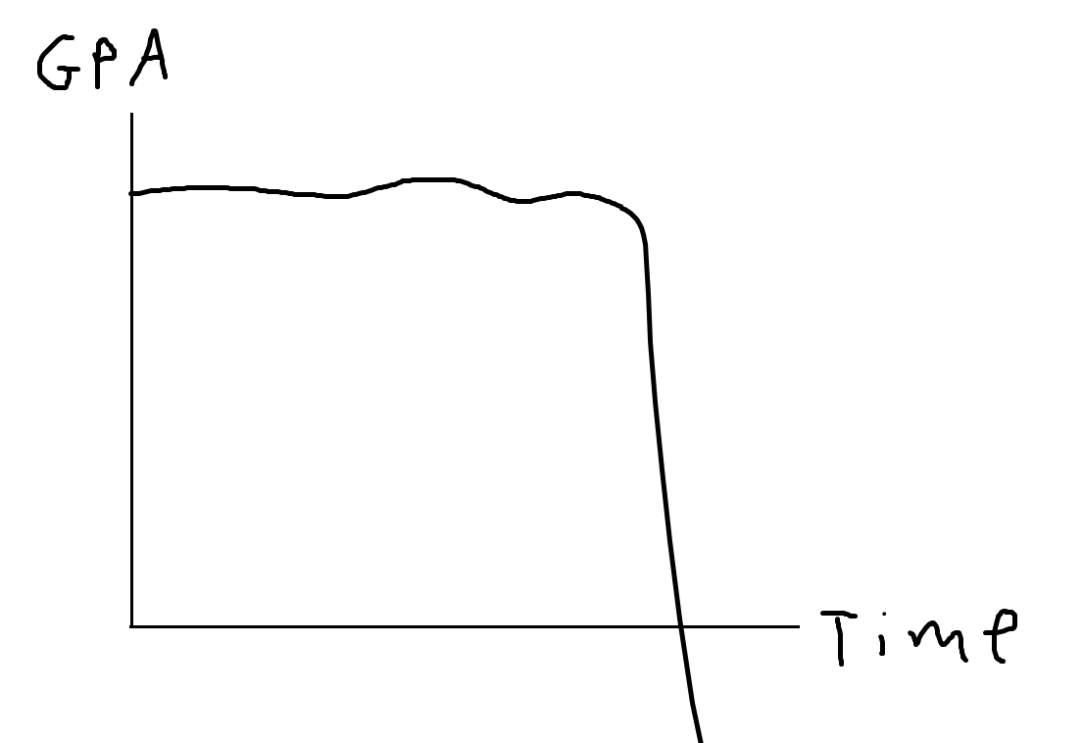
Part 1: Genshin Impact Price Haggling
(dont play genshin your gpa will drop)
Notes:
So lets talk about Genshin impact
Before I do that tho there is a real danger of this talk inspiring someone here to consider playing Genshin impact
So just in case that happens here is some advice and wisdom
DO NOT PLAY GENSHIN

Slide 3
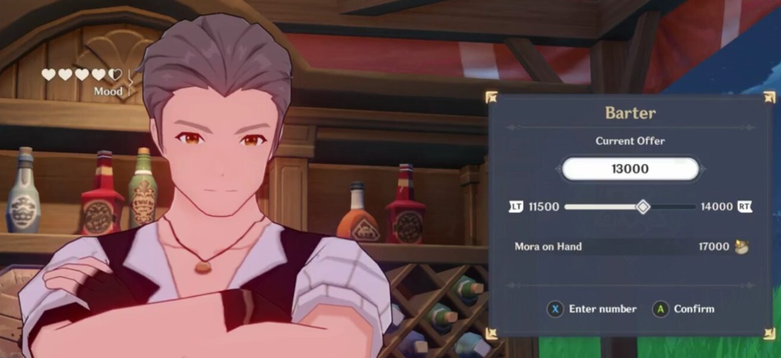
He’s selling barley or something idk
What’s the lowest price that he’ll take?
Notes:
this is a merchant
i wanna buy smth from him
and im going to offer him prices
he’ll accept the first price that is high enough for him, but if i keep lowballing him then he’ll get upset

Slide 4
The Rules
$42
Merchant has some price P in mind that you don’t know.
You’re given an interval that the price can be in.
You have 5 (?) chances to offer a price.
Merchant will accept the first price you offer that is at least P.
[$0, $100]

Slide 5
The Rules
Example #1
$30
$45
$15
$42
Merchant has some price P in mind that you don’t know.
You’re given an interval that the price can be in.
You have 5 (?) chances to offer a price.
Merchant will accept the first price you offer that is at least P.
Goal: Pay as little as you can within the 5 price offers you make.
yes
no
[$0, $100]

Slide 6
Example #1
Example #2
$0.02
$0.01
$0.03
$0.04
$100
$16
Merchant has some price P in mind that you don’t know.
You’re given an interval that the price can be in.
You have 5 (?) chances to offer a price.
Merchant will accept the first price you offer that is at least P.
Goal: Pay as little as you can within the 5 price offers you make.
no
yes
[$0, $100]

Slide 7
Mathematical Formulation
Price P is a real number in [0,1], chosen uniformly at random.
Have n attempts to offer a price.
Let our price offers be a₁, a₂, ..., a_{n}.
(Note: May as well choose all these numbers at the beginning)
The first price offer a_{i} that is ≥ P is the amount we pay.
What price offers do we choose to minimize the expected value of the amount of money we pay?

Slide 8
A small Reformulation
Instead of working with the a_{i}’s, let’s work with the numbers {x_{i}} which represent the increments.
They satisfy the constraint x₁+x₂+ ... +x_{n-1}+x_{n}= 1
x₁
x₂
x₃
x_{n}
0
a₁
a₂
a₃
a_{n} = 1

Slide 9
What’s the expected payment?
x₁ chance that the price P is in this interval.
In this case we pay x₁.
Contributes x₁(x₁) to the expected payment.
E = x₁(x₁)
+ ...
0
x₁
x₂
x₃
x_{n}
1

Slide 10
What’s the expected payment?
x₂ chance that the price P is in this interval.
In this case we pay x₁+ x₂.
Contributes x₂(x₁+ x₂) to the expected payment.
E = x₁(x₁)
+ ...
+ x₂(x₁+ x₂)
+ ...
0
x₁
x₂
x₃
x_{n}
1

Slide 11
What’s the expected payment?
x₃ chance that the price P is in this interval.
In this case we pay x₁+ x₂+ x₃.
Contributes x₃(x₁+ x₂+ x₃) to the expected payment.
E = x₁(x₁)
+ x₂(x₁+ x₂)
+ x₃(x₁+ x₂+ x₃)
+ ...
+ ...
0
x₁
x₂
x₃
x_{n}
1

Slide 12
What’s the expected payment?
E = x₁(x₁)
+ x₂(x₁+ x₂)
+ x₃(x₁+ x₂+ x₃)
+ ...
+ x_{n}(x₁+ x₂+ x₃ + ... + x_{n})

Slide 13
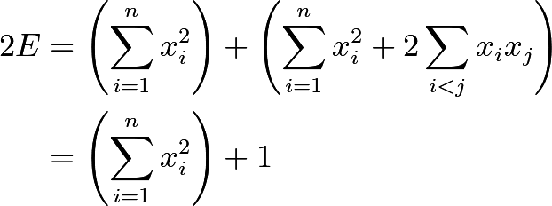
Less notation-dense half of the screen
(n=3)
Notes:
\begin{align*}
\implies &\phantom{++}\!\! x_1^2+x_2^2+x_3^2 \\
&+ 2(x_1x_2+x_1x_3+x_2x_3)=1
\end{align*}
\begin{align*}
2E &= \left(\sum_{i=1}^n x_i^2\right) + \left(\sum_{i=1}^n x_i^2 + 2\sum_{i < j}x_ix_j\right)\\
&= \left(\sum_{i=1}^n x_i^2\right) + 1
\end{align*}

Slide 14
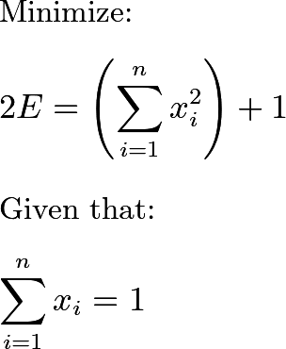
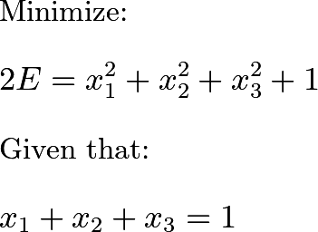
Less notation-dense half of the screen
(n=3)
Notes:
Minimize:
$\displaystyle 2E = \left(\sum_{i=1}^n x_i^2\right)+1$
Given that:
$\displaystyle \sum_{i=1}^n x_i=1$

Slide 15
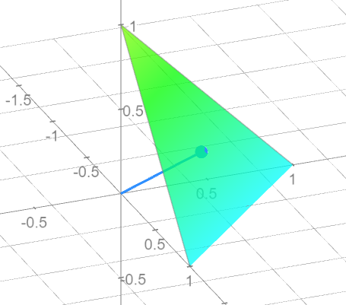
Visual Proof

Slide 16
You can use something called the QM-AM inequality, which states that:
Rigorous Proof
Moreover, it turns out that the ≥ is an = exactly when all the variables are equal.
That is, we get the minimum value exactly when all the variables are equal.

Slide 17
Conclusion
$20, $40, $60, $80, $100
$__
In the optimal strategy, all the increments are equal.
So, the optimal strategy is to offer the prices 1/n, 2/n, 3/n, ..., n/n.
This results in an expected price paid of:
[$0, $100]

Slide 18
Part II: Love Live School Idol Festival
rip

Slide 19
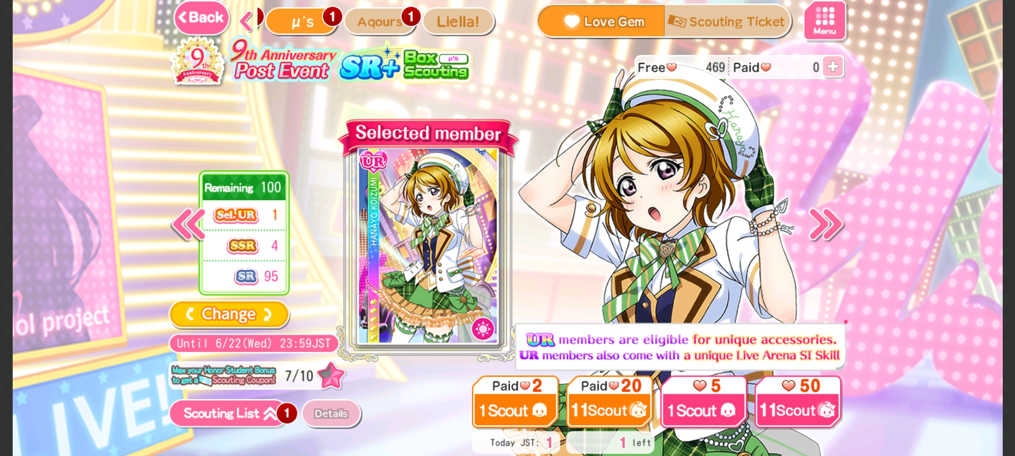
(it’s another gacha game)
The game is dead now, but let’s metagame their gacha anyway!

Slide 20
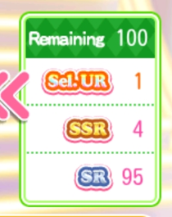
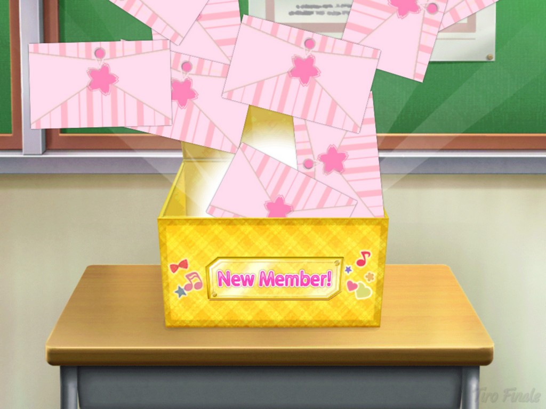
Box Scouting
← Good card
Given a shuffled deck of 100 cards.
Exactly one card (“Hanayo”) has any worth whatsoever.
Can pay love gems to draw (“pull”) cards from the top of the deck:
Option 1: Pay 5 gems to pull 1 card
Option 2: Pay 50 gems to pull 11 cards
What strategy will get Hanayo using the least amount of love gems (in expectation)?
Trash

Slide 21
What do you think?
Vote for the best strategy!
A) Keep doing 11-pulls (for 50 gems) until we get Hanayo.
B) Keep doing 1-pulls (for 5 gems) until we get Hanayo.
C) Neither.

Slide 22
*drum roll*
Expected spending under strategy A (11-pulls):
Expected spending under strategy B (1-pulls):
Therefore, strategy A is optimal.
Just kidding! We can do better (!!!).

Slide 23
Problem-solving strategy: Consider extreme cases and/or variants
Extremely Large Deck (n = 1,000,000)
Very Small Deck (n = 11):
Observation: 11-pulls are better when deck is big, but 1-pulls are better when deck is small
Rationale:
When deck is big, 11-pulls save money on average in the long run.
When deck is small, 1-pulls save spending money on unnecessary pulls.

Slide 24
A better strategy
This hints at the optimal strategy: “Do 11-pulls while the deck is large, but switch to 1-pulls once the deck gets smaller.”
When do we switch from 11-pulls to 1-pulls?
For a deck of 100 cards, if we do k 11-pulls followed by (100-11k) 1-pulls, the expected amount of gems spent is:
This is minimized when k = 5

Slide 25
Conclusion
Strategy A: Keep doing 11-pulls (for 50 gems) until we get Hanayo.
Strategy B: Keep doing 1-pulls (for 5 gems) until we get Hanayo.
Strategy C: Do “5 11-pulls, and then 45 1-pulls” until we get Hanayo.
Strategy | Expected Love Gems Spent
A | 252.05
B | 252.50
C | 246.75
Using math, millions of Love Live School Idol Festival gamers could have saved more than 5 gems in expectation in box scouting!

Slide 26
Part III: Minecraft
An actually good game in my math talk? Impossible!

Slide 27
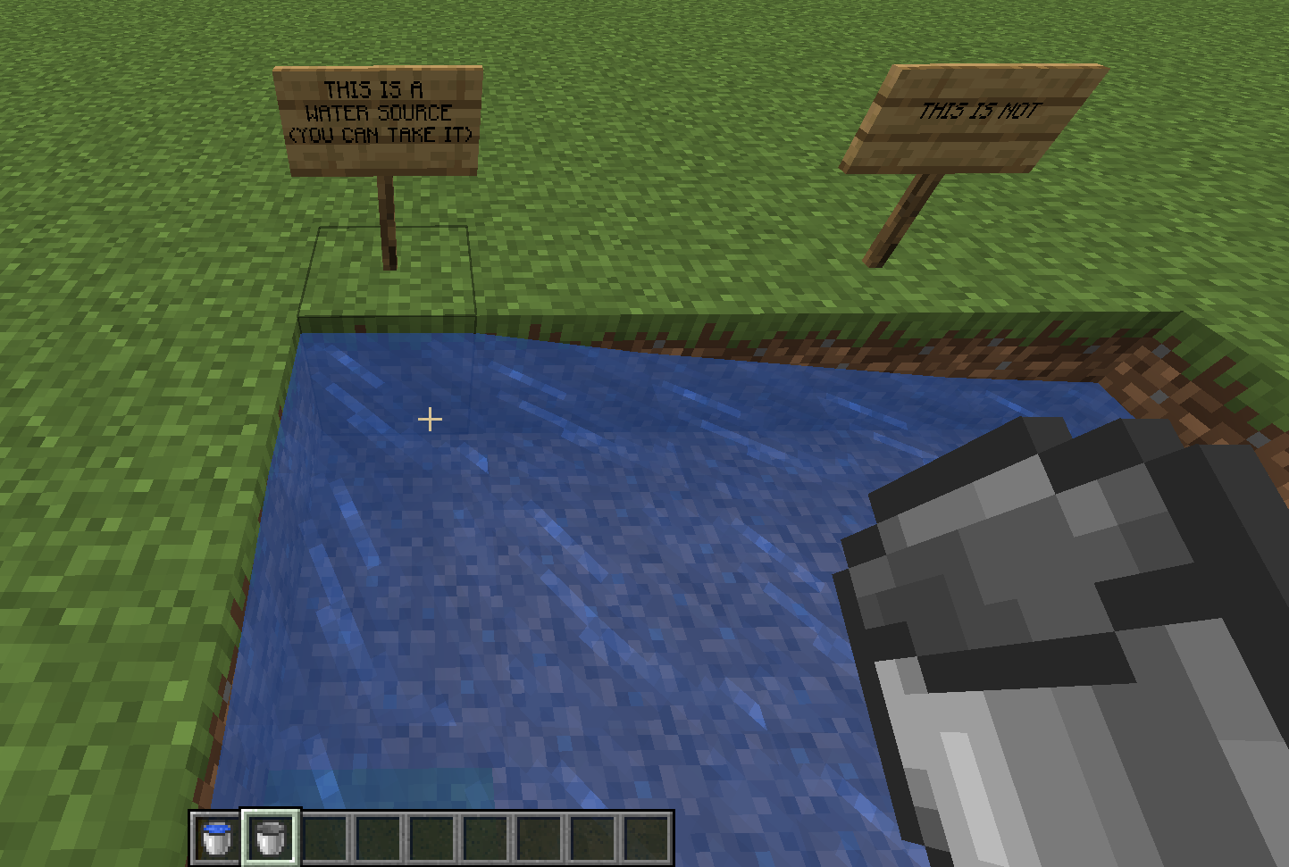
Water source vs. normal water
You can pick up water sources with an empty bucket. (These are the stuff we’ll care about in this talk.)

Slide 28
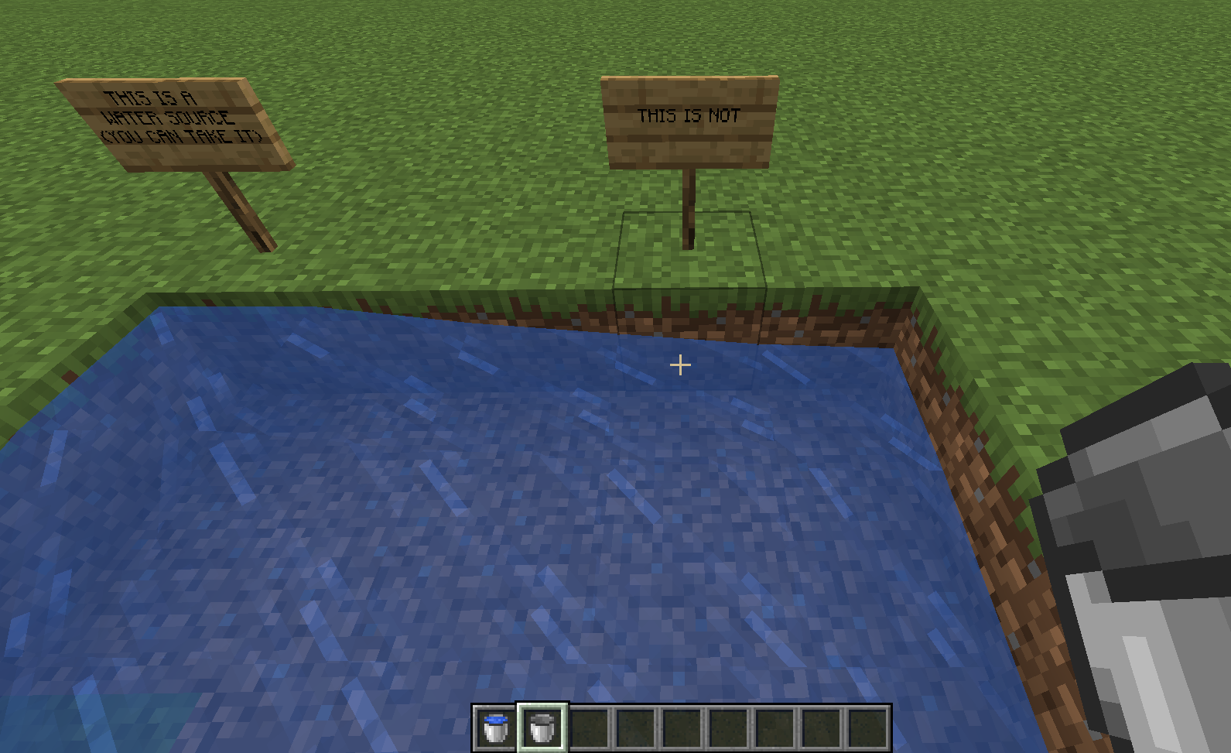
Water source vs. normal water
All the other water you see flows from the water source, and can’t be picked up. (We literally will not care about these guys. Pretend you never saw this slide. You saw nothing. It was never here. We can move on now. There is only water source. Water source good. There is no normal water current flow in ba sing se.)

Slide 29
How do you get infinite water?
It’s super easy and well-known! Just follow these steps!

Slide 30
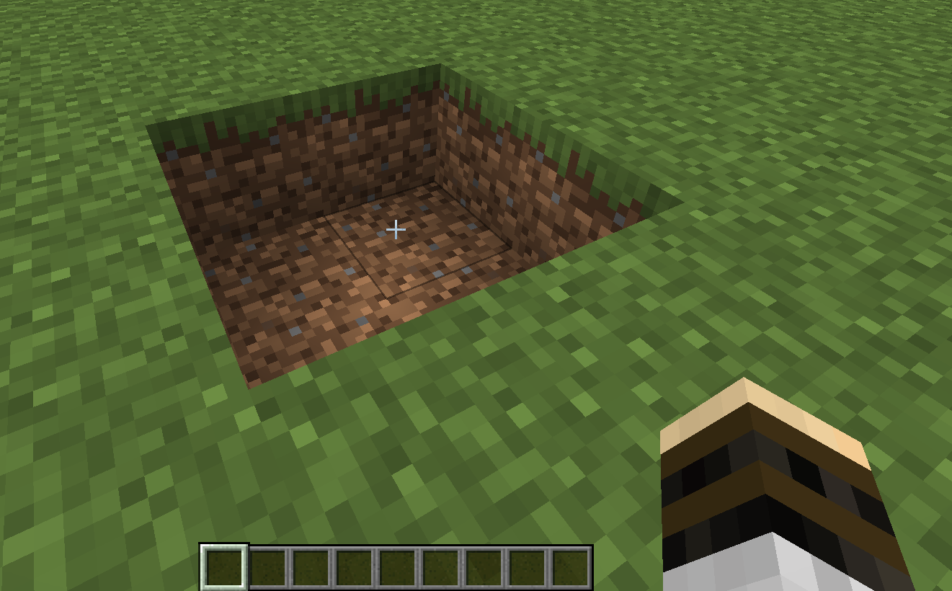
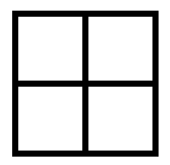
Step 1
Dig a 2x2 hole

Slide 31
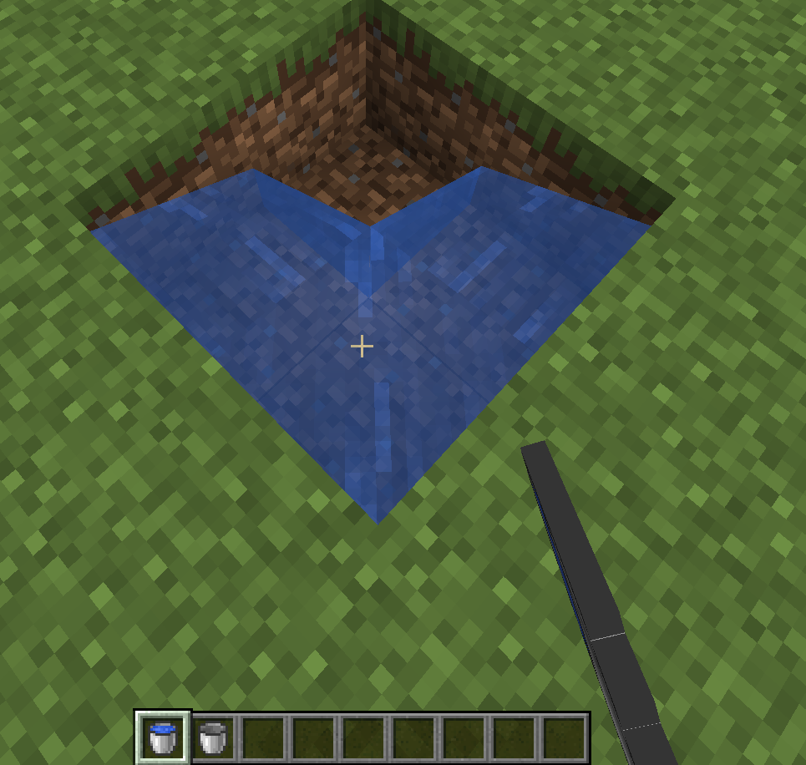
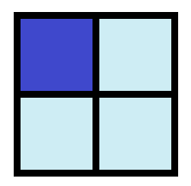
Step 2
Put a water source in one corner

Slide 32
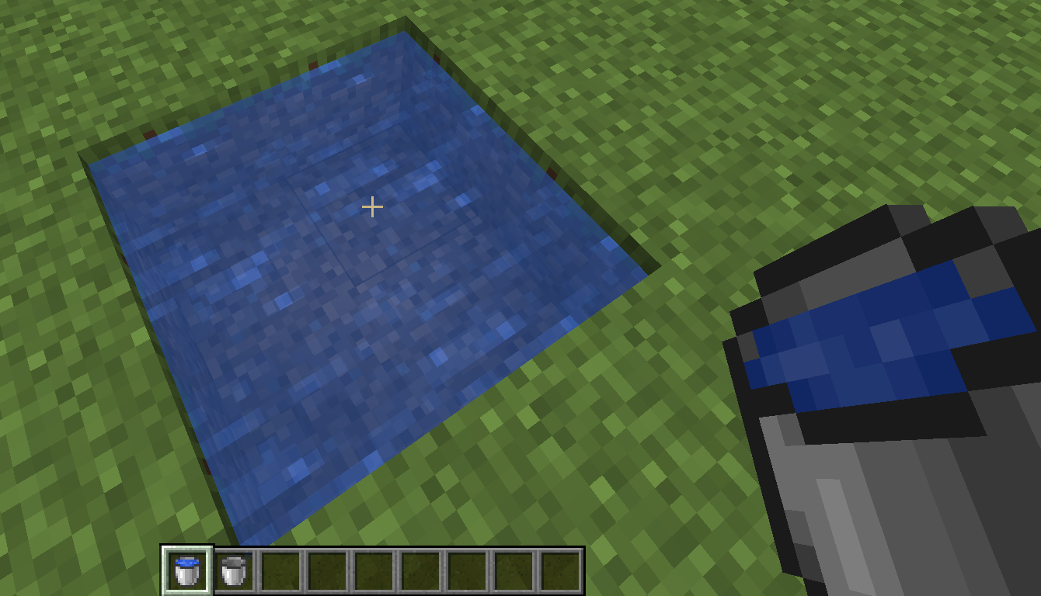
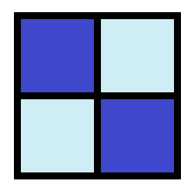
Step 3
Put a water source in the other corner

Slide 33
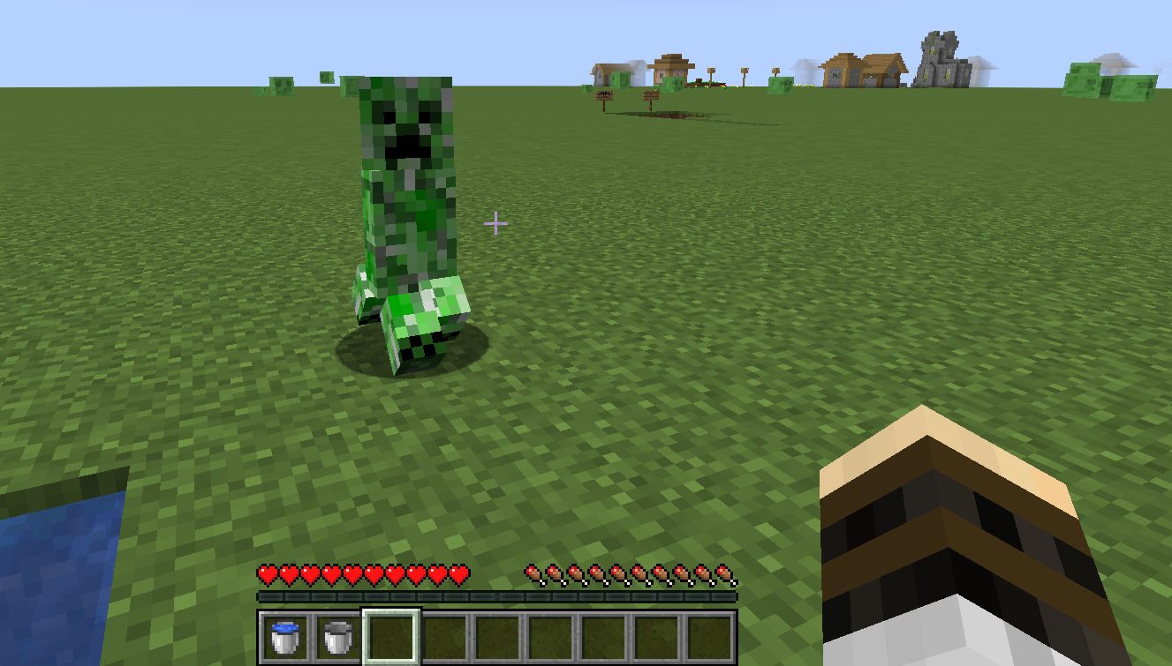
Step 4
???
These will convert to water source blocks!

Slide 34
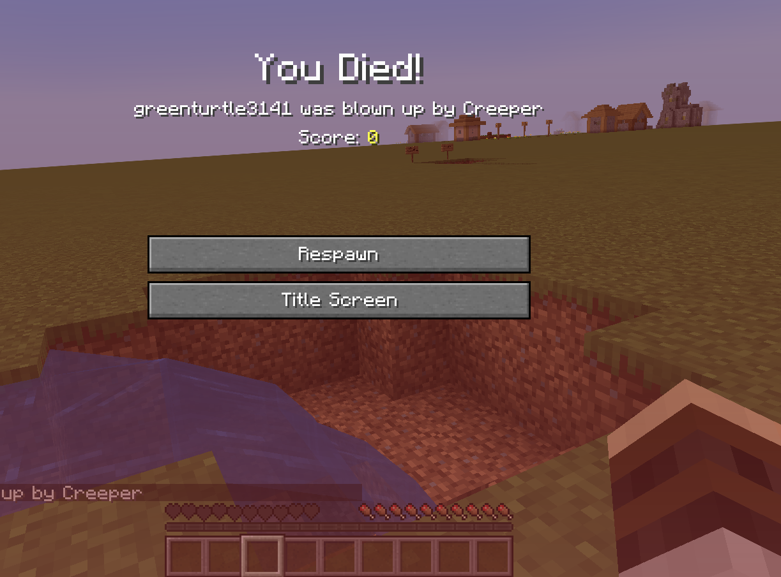
Step 5
Profit!
These will convert to water source blocks!

Slide 35
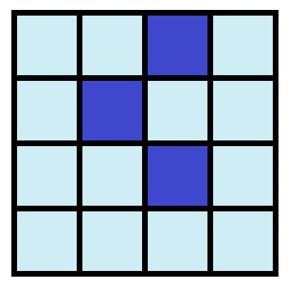
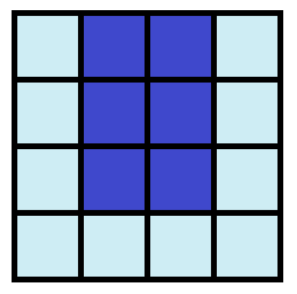
Why does this work?
Rule: If a block is orthogonally adjacent to at least 2 water source blocks, then it is converted into a water source block!

Slide 36
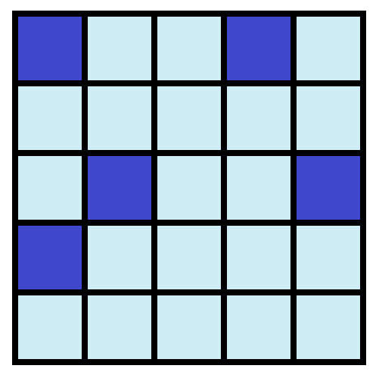
Example

Slide 37
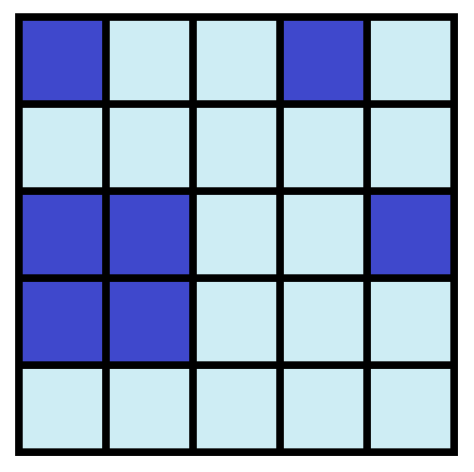
Example

Slide 38
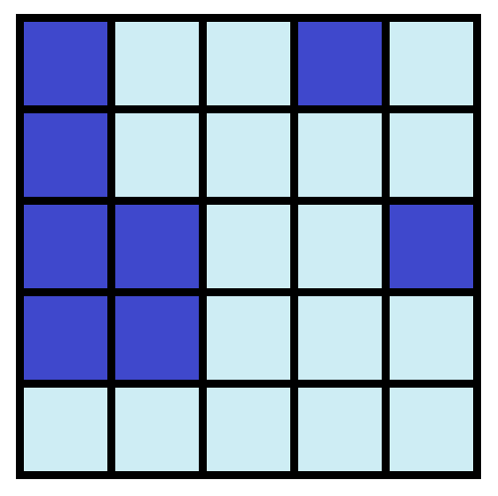
Example

Slide 39
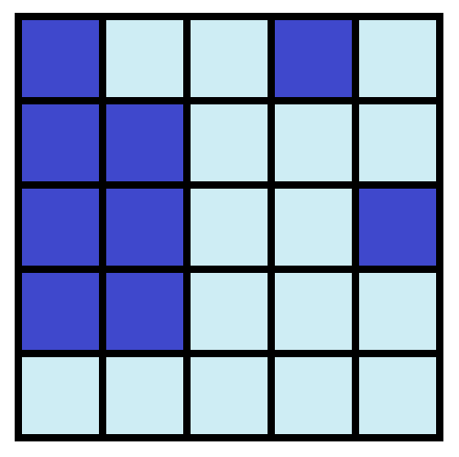
Example

Slide 40
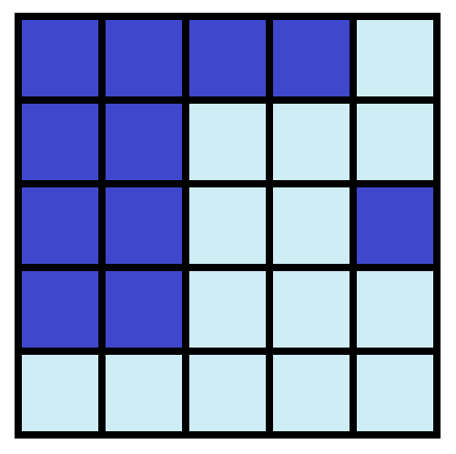
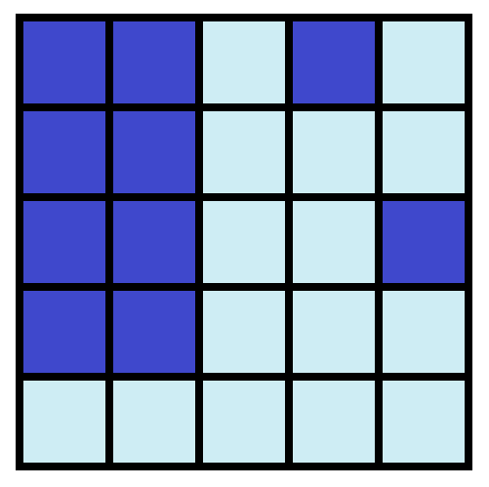
Example

Slide 41
Example

Slide 42
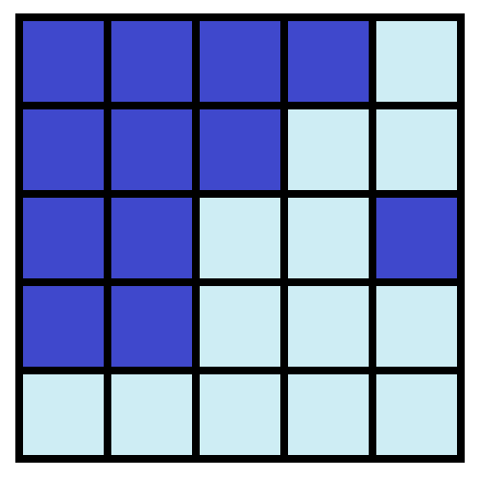
Example

Slide 43
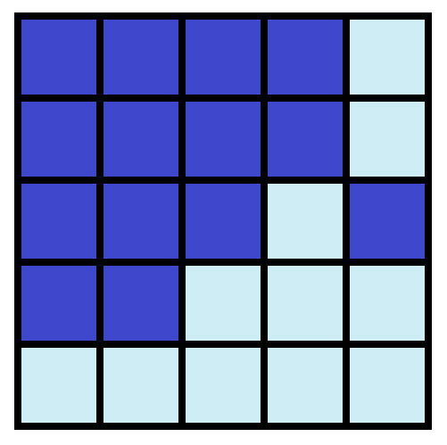
Example

Slide 44
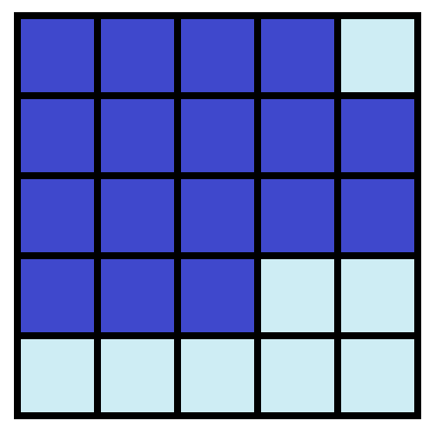
Example

Slide 45
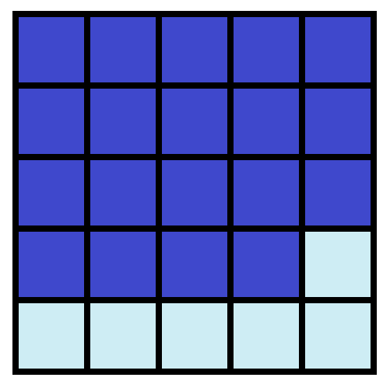
Example

Slide 46
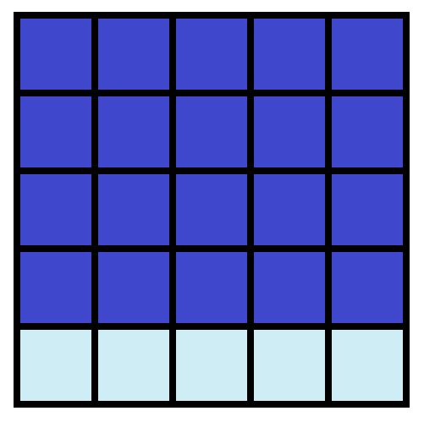
Example

Slide 47
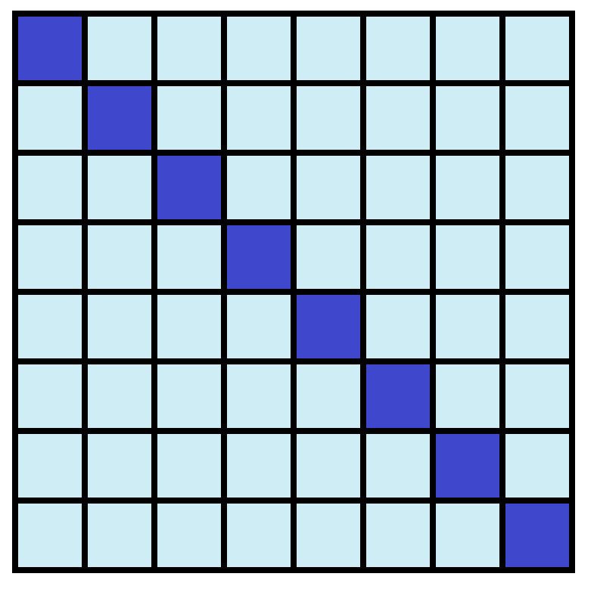
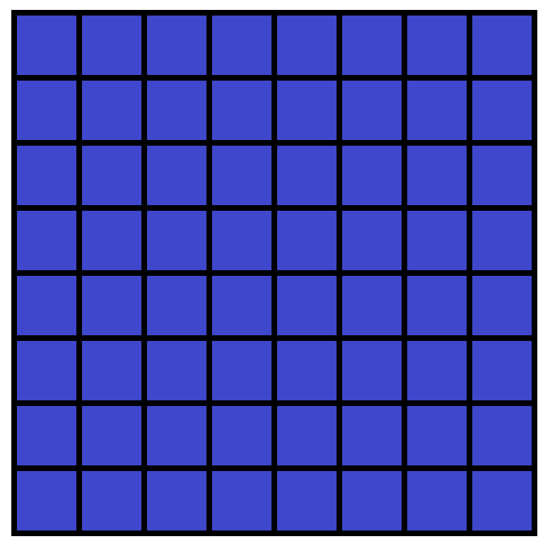
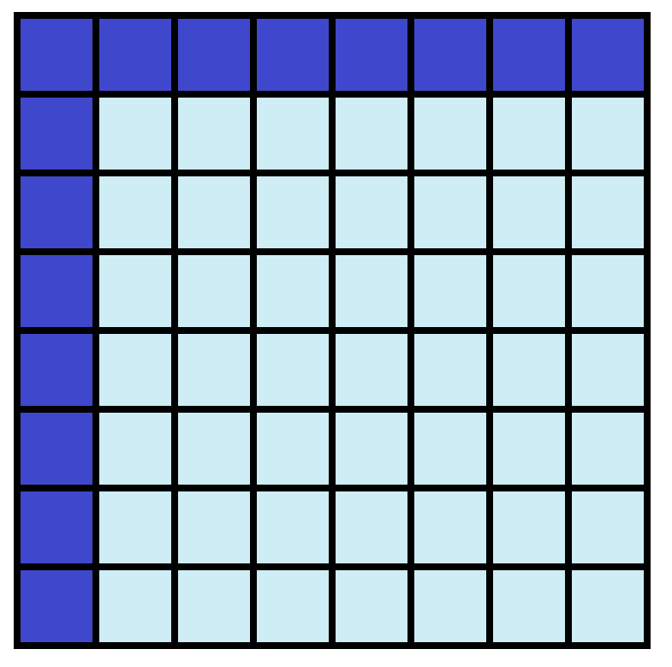
The Math Question
What is the least number of water sources you need to place into an n x n grid so that the entire grid becomes all water sources?
Theorem: n is the minimum.

Slide 48
Proof
Key Idea: In combinatorial problems like these, it is often useful to look for some quantity that doesn’t change or always increases/decreases.
These are called invariants and monovariants, respectively.
One very dumb example of a monovariant is the number of water sources. Obviously this always goes up (or stay the same) as the water spreads.
It turns out that there’s something interesting that always decreases (or stays the same) as the water spreads. Can you find it?

Slide 49
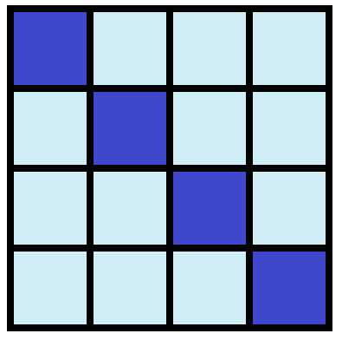
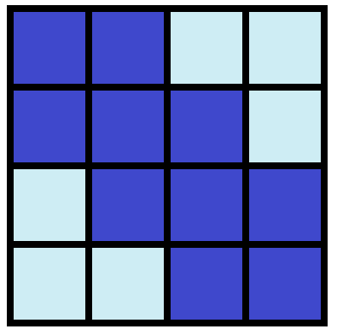
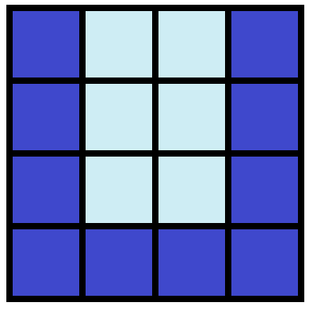
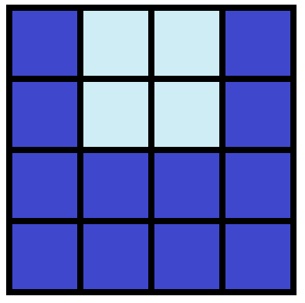
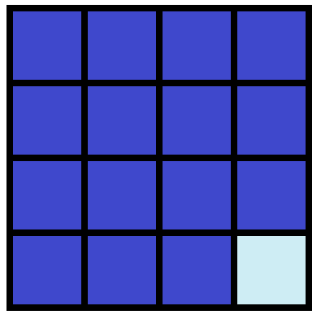
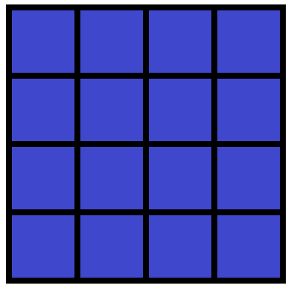
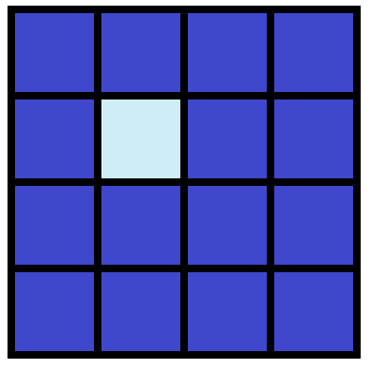
The perimeter of the water (!!!)...
The quantity I’m thinking of...
...stays the same for these guys.
...decreases for these guys.

Slide 50
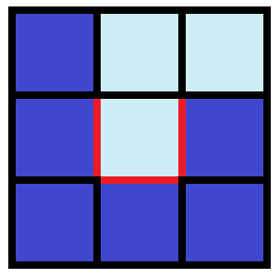
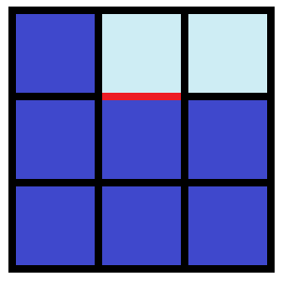
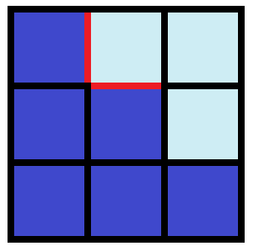
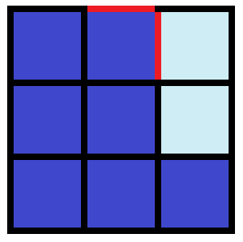
Why does the perimeter never increase?

Slide 51
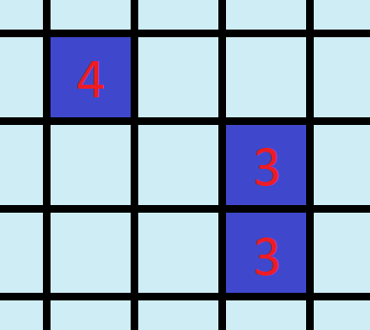
How does this help prove the theorem?
The perimeter of the completed square is 4n.
Since the water perimeter can only decrease, it follows that:
Each water block at the start can’t contribute more than 4 to the perimeter.
Therefore, there must be at least n water source blocks at the start.

Slide 52
Part 1V: Genshin Impact Price Haggling
(dont play genshin your gpa will drop)

Slide 53
He’s selling barley or something idk
What’s the lowest price that he’ll take?
Notes:
this is a merchant
i wanna buy smth from him
and im going to offer him prices
he’ll accept the first price that is high enough for him, but if i keep lowballing him then he’ll get upset

Slide 54
Mathematical Formulation
Evil (but very interesting) Generalization
Price P is a real number in [0,1], chosen uniformly at random.
Have n attempts to offer a price.
Let our price offers be a₁, a₂, ..., a_{n}.
(Note: May as well choose all these numbers at the beginning)
The first price offer a_{i} that is ≥ P is the amount we pay.
What price offers do we choose to minimize the expected value of the amount of money we pay?
from any probability distribution.
Assuming I follow an optimal strategy, what probability distribution maximizes how much more than P I’ll have to pay (in expectation)?

Slide 55
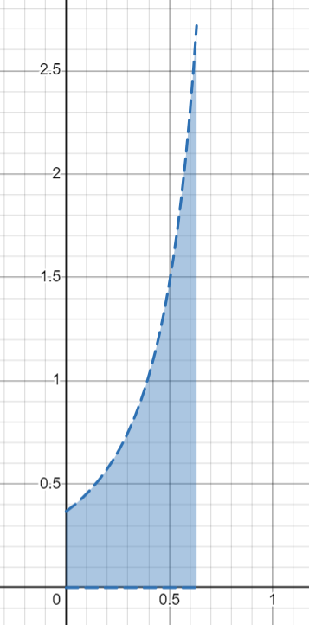
Current Results
Let E_{n} be the worst possible difference between the expected value and the actual price, over all possible probability distributions, where we can make n offers.
Not too hard to show that 1/(2n) ≤ E_{n} ≤ 1/n.
Specific values:
E₁ = 1
E₂ = 1/e
E₃ = we have absolutely no idea
Conjecture:
pdf for n=2

Slide 56
Concluding remarks
“Math is everywhere” is cliche. Nonetheless, it is true that our hobbies can not only present interesting mathematical exercises, but also serve as an inspirational groundwork for finding even greater problems and avenues for research.
Don’t play Genshin.

Slide 57
Thanks for listening!
Contact: thomas.lam@cims.nyu.edu
Website: https://cims.nyu.edu/~tjl8195/

